Slide 1


5: Visualizing Data with Pandas and Matplotlib

Slide 2
Visualizing Data with Pandas and Matplotlib
In this lesson, we will cover the following topics:
An introduction to matplotlib
Plotting with pandas
The pandas.plotting module
Notes:
So far, we have been working with data strictly in a tabular format. However, the human brain excels at picking out visual patterns; hence, our natural next step is learning how to visualize our data. Visualizations make it much easier to spot aberrations in our data and explain our findings to others. However, we should not reserve data visualizations exclusively for those we present our conclusions to, as visualizations will be crucial in helping us understand our data quickly and more completely in our exploratory data analysis.
There are numerous types of visualizations that go way beyond what we may have seen in the past. In this lesson, we will cover the most common plot types, such as line plots, histograms, scatter plots, and bar plots, along with several other plot types that build upon these. We won't be covering pie charts—they are notorious for being difficult to read properly, and there are better ways to get our point across.
Python has many libraries for creating visualizations, but the main one for data analysis (and other purposes) is matplotlib. The matplotlib library can be a little tricky to learn at first, but thankfully, pandas has its own wrappers around some of the matplotlib functionality, allowing us to create many different types of visualizations without needing to write a single line with matplotlib (or, at least, very few). For more complicated plot types that aren't built into pandas or matplotlib, we have the seaborn library, which we will discuss in the next lesson. With these three at our disposal, we should be able to create most (if not all) of the visualizations we desire. Animations and interactive plots are beyond the scope of this course, but you can check out the Further reading section for more information.

Slide 3
An introduction to matplotlib
The plotting capabilities in pandas and seaborn are powered by matplotlib: both of these packages provide wrappers around the lower-level functionality in matplotlib.
Consequently, we have many visualization options at our fingertips with minimal code to write; however, this comes at a price: reduced flexibility in what we can create.
Notes:
We may find that the pandas or seaborn implementation isn't quite meeting our needs, and, indeed, it may be impossible to override a particular setting after creating the plot with them, meaning we will have to do some of the legwork with matplotlib. Additionally, many of the tweaks that will be made to the final appearance of the visualization will be handled with matplotlib commands, which we will discuss in the next lesson. Therefore, it would greatly benefit us to have some understanding of how matplotlib works.

Slide 4
The basics
Rather than importing the whole matplotlib package, we will only import the pyplot module using the dot (.) notation; this reduces the amount of typing we need to do in order to access what we need, and we don't take up more space in memory with code we won't use.
Note that pyplot is traditionally aliased as plt:
import matplotlib.pyplot as pltCopy
Notes:
The matplotlib package is rather large since it encompasses quite a bit of functionality. Fortunately for us, for most of our plotting tasks, all we need is the pyplot module, which provides a MATLAB-like plotting framework. Occasionally, we will need to import additional modules for other tasks, such as animations, changing the style, or altering the default parameters; we will see some examples of this in the next lesson.
Before we look at our first plots, let's cover how to actually view them. Matplotlib will create our visualizations with the plot commands; however, we won't see the visualization until we request to see it. It is done in this fashion so that we can continually tweak the visualization with additional code, until we are ready to finalize it. Unless we save a reference to our plot, once it is displayed, we will have to recreate it to change something. This is because the reference to the last plot will have been destroyed to free up resources in memory.
Matplotlib uses the plt.show() function to display the visualization. It must be called after each visualization we create. When using the Python shell, it will also prevent additional code from being executed until the window is closed because it is a blocking function. In Jupyter Notebooks, we can simply use the %matplotlib inline magic command (a special IPython command preceded by a % sign) once, and our visualizations will be automatically displayed when the cell with our visualization code is executed. Magic commands (or magics for short) are run as regular code within a Jupyter Notebook cell. If, up to this point in the course, you haven't been keen on using Jupyter Notebooks and would like to get that set up now, you can refer to lesson 1, Introduction to Data Analysis.
Important note
The %matplotlib inline magic embeds static images of the plot into our notebook. Another common option is the %matplotlib notebook magic. It provides a small level of interactivity to the plot by allowing actions such as resizing and zooming, though note that this requires some additional setup if you're using JupyterLab and can lead to some confusing bugs, depending on the code that's running in the notebook. Check out this article for more information: https://medium.com/@1522933668924/using-matplotlib-in-jupyter-notebooks-comparing-methods-and-some-tips-python-c38e85b40ba1.

Slide 5
The basics
Let's create our first plot in the 1-introducing_matplotlib.ipynb notebook, using the Facebook stock prices data from the fb_stock_prices_2018.csv file in the repository for this lesson.
First, we need to import pyplot and pandas (in this example, we will use plt.show(), so we don't need to run the magic here):
>>> import matplotlib.pyplot as plt
>>> import pandas as pd

Slide 6
The basics
Next, we read in the CSV file and specify the index as the date column, since we know what the data looks like from previous lessons:
>>> fb = pd.read_csv(
... 'data/fb_stock_prices_2018.csv',
... index_col='date',
... parse_dates=True
... )

Slide 7
The basics
To understand how Facebook's stock has evolved over time, we can create a line plot of the daily opening price.
For this task, we will use the plt.plot() function, providing the data to be used on the x-axis and y-axis, respectively.
We will then follow up with a call to plt.show() to display it:
>>> plt.plot(fb.index, fb.open)
>>> plt.show()

Slide 8
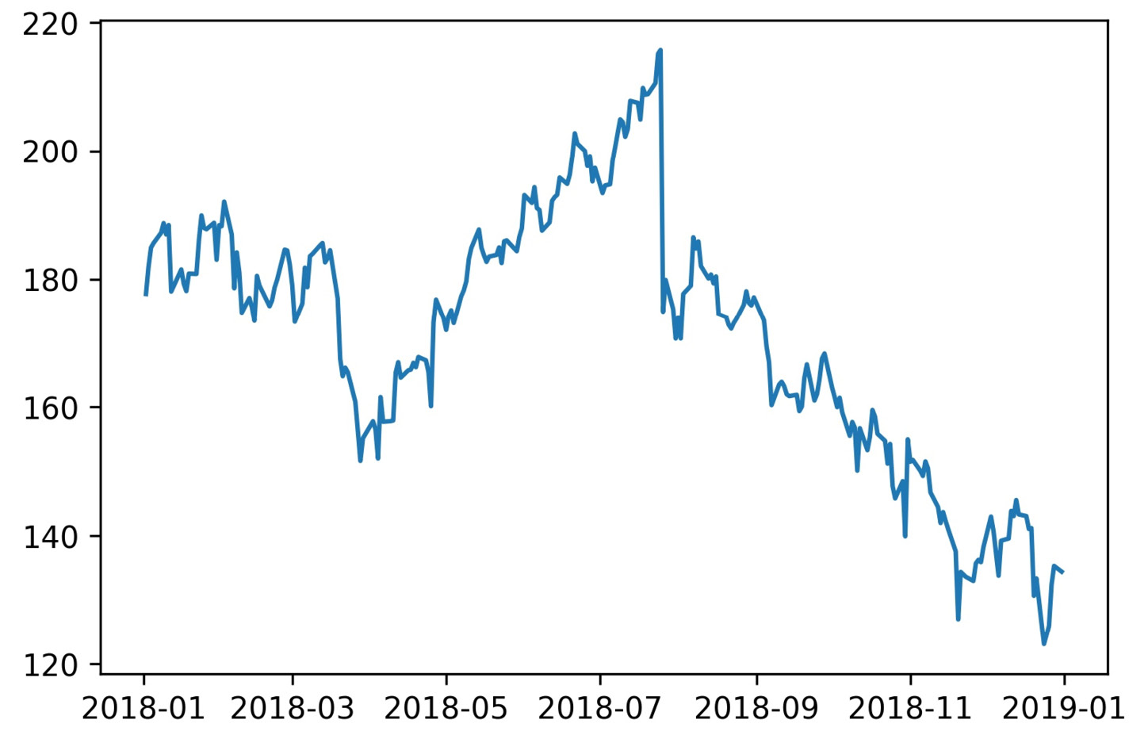
The basics
The result is the following plot:
Notes:
If we want to present this visualization, we would have to go back and add our axis labels, plot title, legend (if applicable), and possibly fix the y-axis range; this will be covered in the next lesson when we discuss formatting and customizing the appearance of our plots. Pandas and seaborn will take care of some of this for us, at least.
For the remainder of this course, we will be using the %matplotlib inline magic command (remember, this needs to be used in a Jupyter Notebook to work), so we won't be calling plt.show() after our plotting code.

Slide 9
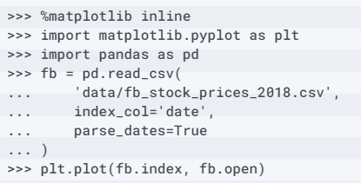
The basics
The following code gives the same output as the preceding block:
Notes:
Important note
Be sure to run the %matplotlib inline magic command now if you are using a Jupyter Notebook. This ensures that the plotting code in the rest of this lesson displays the output automatically.
We can also use the plt.plot() function to generate scatter plots, provided that we specify a format string for the plot as the third argument. A format string is of the form '[marker][linestyle][color]'; for example, '--k' for a black dashed line. Since we don't want a line for the scatter plot, we omit the linestyle component. We can make a scatter plot of red circles with the 'or' format string; here, o is for circles and r is for the color red. The following code generates a scatter plot of high price versus low price.

Slide 10
The basics
Notice that we can pass our dataframe in the data argument and then use the string names for the columns, instead of passing the series as x and y:
>>> plt.plot('high', 'low', 'or', data=fb.head(20))
Notes:
Barring days of large fluctuations, we would expect the points to be in the form of a line, since the high and low prices won't be far from each other.

Slide 11
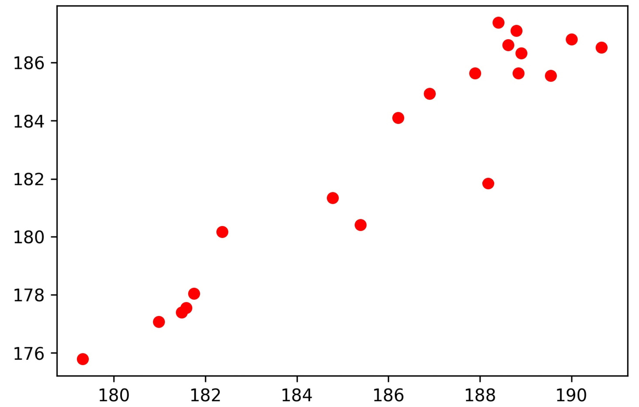
The basics
This is true for the most part, but be careful of the scale that was generated automatically—the x-axis and the y-axis don't line up perfectly:
Notes:
Note that there is some flexibility in specifying the format string. For instance, a format string of the form '[color][marker][linestyle]' will work unless it is ambiguous.

Slide 12
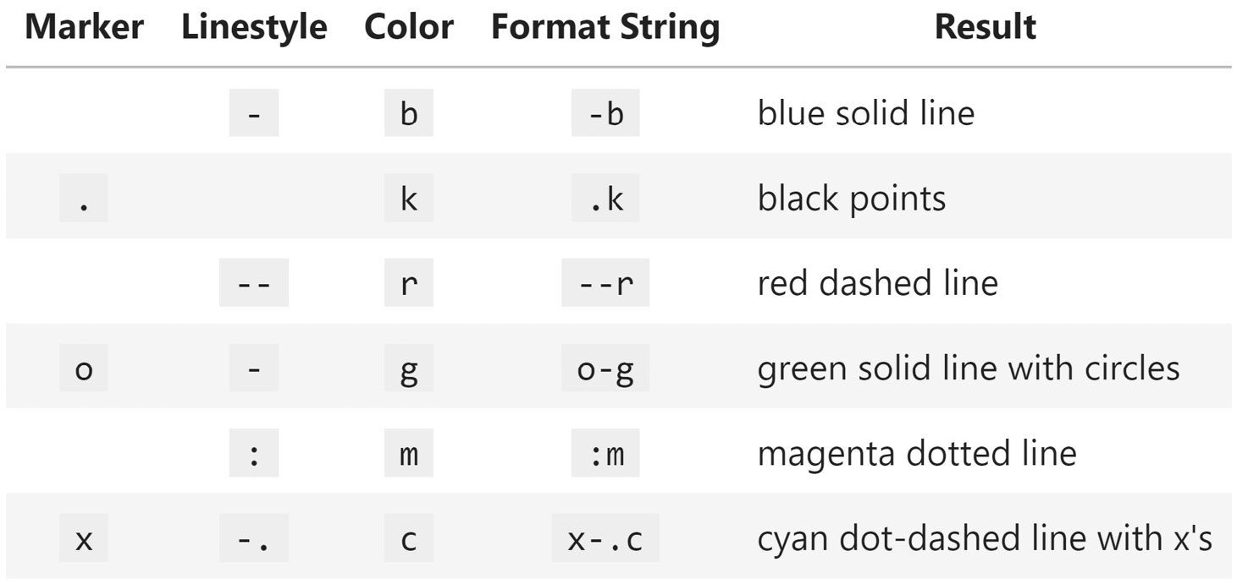
The basics
The following table shows some examples of how to formulate a format string for a variety of plot styles; the complete list of options can be found in the Notes section in the documentation at https://matplotlib.org/api/_as_gen/matplotlib.pyplot.plot.html:
Notes:
The format string is a handy way of specifying many options at once, and the good news, as we will see in the Plotting with pandas section, is that it works with the plot() method in pandas as well. However, if we would rather specify each option separately, we can use the color, linestyle, and marker arguments; check out the values we can pass as keyword arguments to plt.plot() in the documentation—pandas will also pass these down to matplotlib for us.
Tip
As an alternative to defining styles per variable being plotted, consider trying out cycler from the matplotlib team to specify which combinations matplotlib should cycle between (https://matplotlib.org/gallery/color/color_cycler.html). We will see an example of this in lesson 7, Financial Analysis – Bitcoin and the Stock Market.

Slide 13
The basics
To create histograms with matplotlib, we use the hist() function instead.
Let's make a histogram of the earthquake magnitudes in the earthquakes.csv file, using those measured with the ml magnitude type:
>>> quakes = pd.read_csv('data/earthquakes.csv')
>>> plt.hist(quakes.query('magType == "ml"').mag)

Slide 14
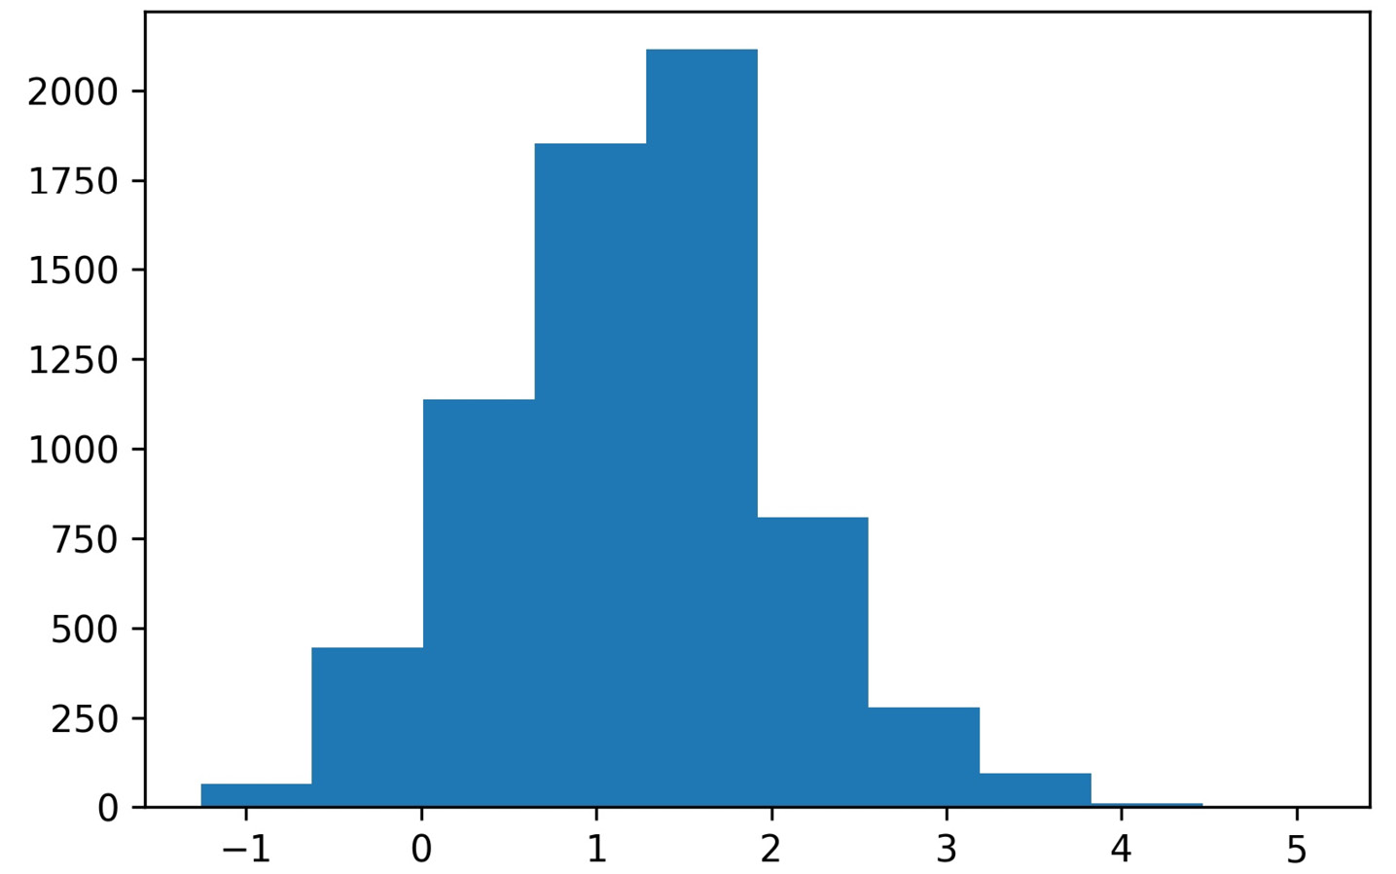
The basics
The resulting histogram gives us an idea of the range of earthquake magnitudes we can expect using the ml measurement technique:
Notes:
As we could have guessed, the magnitudes tend to be small, and the distribution appears to be somewhat normal. However, a word of caution regarding histograms—bin size matters. There are cases where we can change the number of bins the data is divided into and change what the histogram indicates the distribution to be.

Slide 15
The basics
For example, if we make two histograms for this data using different numbers of bins, the distributions look different:
>>> x = quakes.query('magType == "ml"').mag
>>> fig, axes = plt.subplots(1, 2, figsize=(10, 3))
>>> for ax, bins in zip(axes, [7, 35]):
... ax.hist(x, bins=bins)
... ax.set_title(f'bins param: {bins}')

Slide 16
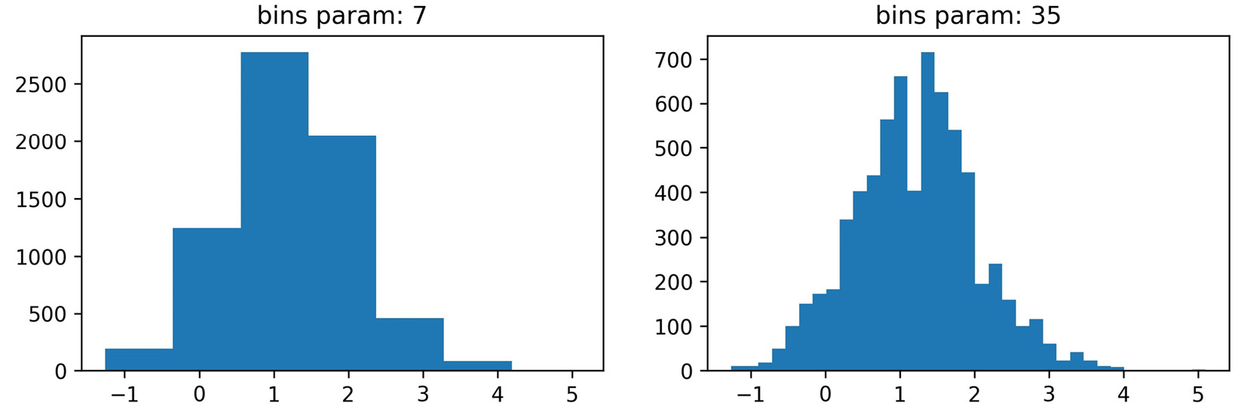
The basics
Notice how the distribution appears unimodal in the left subplot, but seems bimodal in the right subplot:
Notes:
Tip
Some common rules of thumb for selecting the number of bins can be found at https://en.wikipedia.org/wiki/Histogram#Number_of_bins_and_width. However, note that, in some cases, a bee swarm plot can be easier to interpret than a histogram; this can be created with seaborn, as we will see in lesson 6, Plotting with Seaborn and Customization Techniques.

Slide 17
The basics
There are a couple of additional things to note from this example, which we will address in the next section on plot components:
We can make subplots.
Plotting functions in pyplot can also be used as methods of matplotlib objects, such as Figure and Axes objects.
Notes:
One last thing regarding basic usage that we will find handy is saving plots as images—we shouldn't be limited to showing the figures in Python only. We can save the last figure with the plt.savefig() function by passing in the path to save the image at; for example, plt.savefig('my_plot.png'). Note that, if plt.show() was called prior to saving, the file will be empty, since the reference to the last plot will be gone after the call to plt.show() (matplotlib closes the Figure object to free up resources in memory). With the %matplotlib inline magic command, we can both see and save our image in the same cell.

Slide 18
Plot components
We use the plt.figure() function to create Figure objects; these will have zero Axes objects until a plot is added:
>>> fig = plt.figure()
<Figure size 432x288 with 0 Axes>
Notes:
In the prior examples using plt.plot(), we didn't have to create a Figure object—matplotlib took care of creating it for us in the background. However, as we saw when creating Figure 5.5, anything beyond a basic plot will require a little more legwork, including creating a Figure object ourselves. The Figure class is the top level for matplotlib visualizations. It contains the Axes objects, which themselves contain additional plot objects, such as lines and ticks. In the case of subplots, the Figure object contains Axes objects with additional functionality.
The plt.subplots() function creates a Figure object with Axes objects for subplots in the arrangement specified. If we ask plt.subplots() for one row and one column, a Figure object with one Axes object will be returned. This can be useful when writing functions that generate subplot layouts based on the input, since we don't need to worry about needing a special case to handle a single subplot.

Slide 19
Plot components
Here, we will specify an arrangement of one row and two columns; this returns a (Figure, Axes) tuple, which we can unpack:
>>> fig, axes = plt.subplots(1, 2)

Slide 20
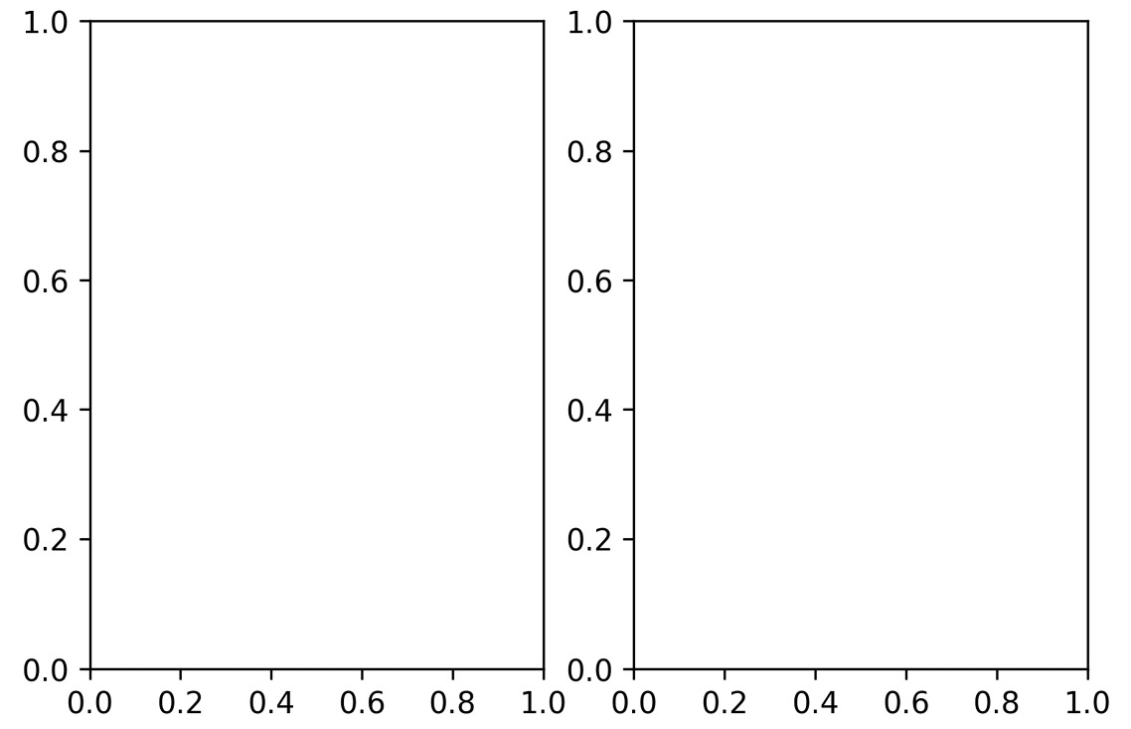
Plot components
When using the %matplotlib inline magic command, we will see the figure that was created:

Slide 21
Plot components
The alternative to using plt.subplots() would be to use the add_axes() method on the Figure object that we get after running plt.figure().
The add_axes() method takes a list in the form of [left, bottom, width, height] as proportions of the figure dimensions, representing the area in the figure this subplot should occupy:
>>> fig = plt.figure(figsize=(3, 3))
>>> outside = fig.add_axes([0.1, 0.1, 0.9, 0.9])
>>> inside = fig.add_axes([0.7, 0.7, 0.25, 0.25])

Slide 22
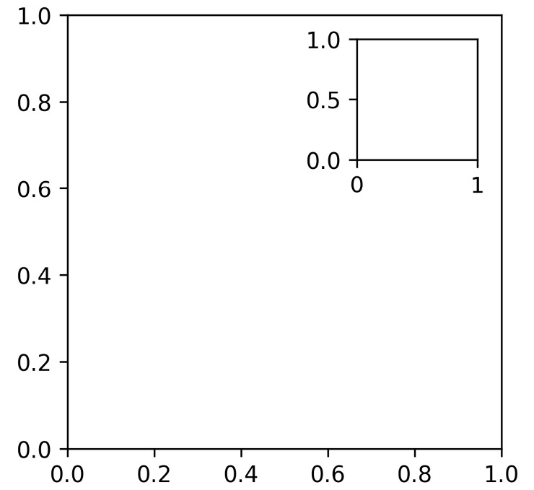
Plot components
This enables the creation of plots inside of plots:
Notes:
If our goal is to keep all the plots separate but not all equally sized, we can use the add_gridspec() method on a Figure object to create a grid for the subplots.

Slide 23
Plot components
Then, we can run add_subplot(), passing in the area(s) from the grid that the given subplot should occupy:
>>> fig = plt.figure(figsize=(8, 8))
>>> gs = fig.add_gridspec(3, 3)
>>> top_left = fig.add_subplot(gs[0, 0])
>>> mid_left = fig.add_subplot(gs[1, 0])
>>> top_right = fig.add_subplot(gs[:2, 1:])
>>> bottom = fig.add_subplot(gs[2,:])

Slide 24
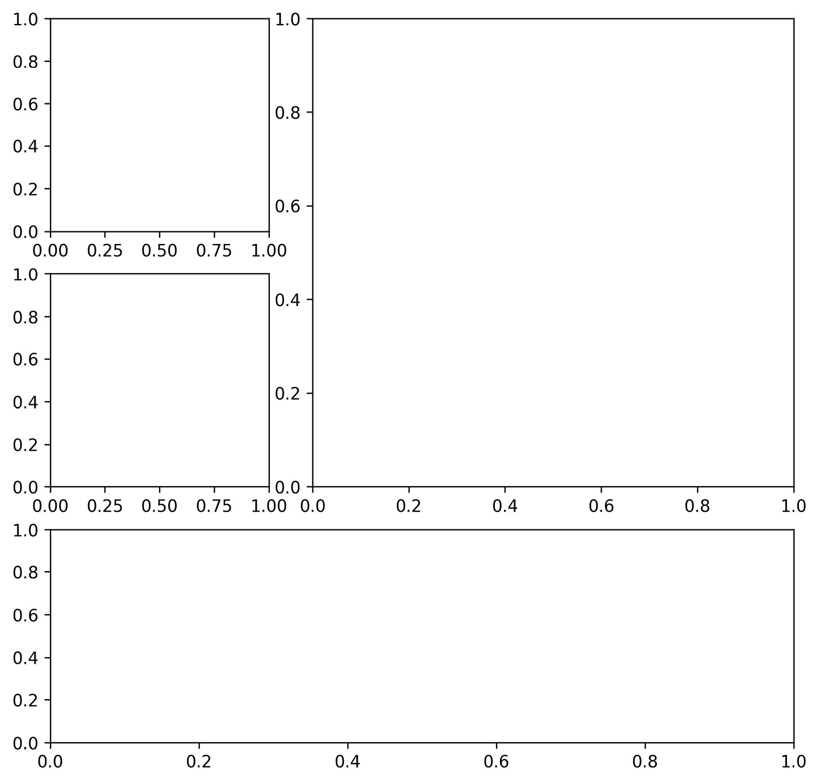
Plot components
This results in the following layout:

Slide 25
Plot components
In the previous section, we discussed how to save visualizations using plt.savefig() but we also can use the savefig() method on Figure objects:
>>> fig.savefig('empty.png')
Notes:
This is very useful to remember since with plt.<func>(), we only have access to the last Figure object; however, if we save the references to our Figure objects, we can work with any of them, regardless of when they were created. Additionally, this foreshadows an important concept that you will notice throughout this lesson: Figure and Axes objects have methods with similar or identical names to their pyplot function counterparts.
While it's convenient to have references to all of the Figure objects we create, it is good practice to close them when we are done with them so that we don't waste any resources. This can be accomplished with the plt.close() function.

Slide 26
Plot components
If we don't pass in anything, it will close the last Figure object; however, we can pass in a specific Figure object to close only that one or 'all' to close all of the Figure objects we have open:
>>> plt.close('all')
Notes:
It's important to get comfortable working with Figure and Axes objects directly as it enables more fine-grained control of the resulting visualizations. This will become evident in the next lesson.

Slide 27
Additional options
The plot() method we will see with pandas also accepts the figsize parameter, so bear this in mind:
>>> fig = plt.figure(figsize=(10, 4))
<Figure size 720x288 with 0 Axes>
>>> fig, axes = plt.subplots(1, 2, figsize=(10, 4))
Notes:
A few of our visualizations looked a little squished. To remedy this, we can pass in a value for figsize in our call to plt.figure() or plt.subplots(). We specify the dimensions with a (width, height) tuple in inches.

Slide 28
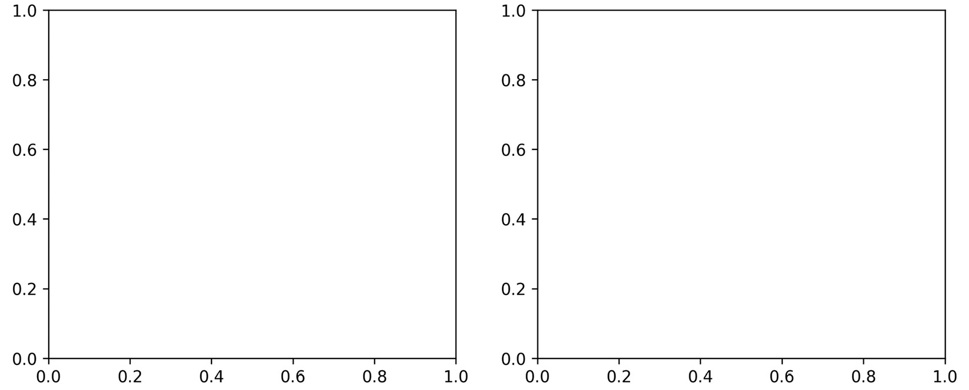
Additional options
Notice that these subplots are more square-shaped than the subplots in Figure when we didn't specify figsize:
Notes:
It's not too bad specifying the figsize parameter for our plots one by one. However, if we find that we are resizing everything to the same size, there's a better alternative. Matplotlib houses its defaults in rcParams, which acts like a dictionary, meaning we can easily overwrite what we wish for our session and get the defaults back when we restart our Python session.

Slide 29
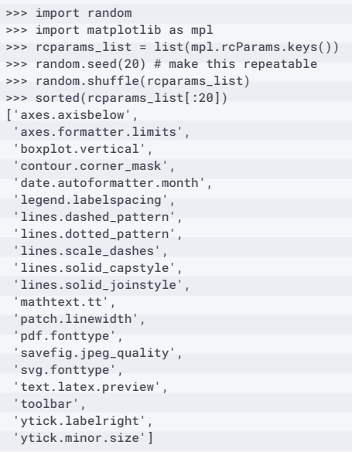
Additional options
Since there are many options in this dictionary (over 300 at the time of writing), let's randomly select a few of them to get an idea of what is available:

Slide 30
Additional options
As you can see, there are many options we can tinker with here.
Let's check what the current default value for figsize is:
>>> mpl.rcParams['figure.figsize']
[6.0, 4.0]

Slide 31
Additional options
To change this for our current session, simply set it equal to a new value:
>>> mpl.rcParams['figure.figsize'] = (300, 10)
>>> mpl.rcParams['figure.figsize']
[300.0, 10.0]
Notes:
Before we move on, let's restore the default settings by using the mpl.rcdefaults() function.

Slide 32
Additional options
The default value for figsize is actually different than what we had previously; this is because %matplotlib inline sets different values for a few of the plot-related parameters when it is first run:
>>> mpl.rcdefaults()
>>> mpl.rcParams['figure.figsize']
[6.8, 4.8]
Notes:
Note that we can also use the plt.rc() function to update a particular setting if we know its group (figure, in this case) and parameter name (figsize).

Slide 33
Additional options
As we did previously, we can use plt.rcdefaults() to reset the defaults:
# change `figsize` default to (20, 20)
>>> plt.rc('figure', figsize=(20, 20))
>>> plt.rcdefaults() # reset the default
Notes:
Tip
If we find ourselves making the same changes every time we start Python, we should look into reading our configuration in rather than updating the default values each time. Consult the mpl.rc_file() function for more information.

Slide 34
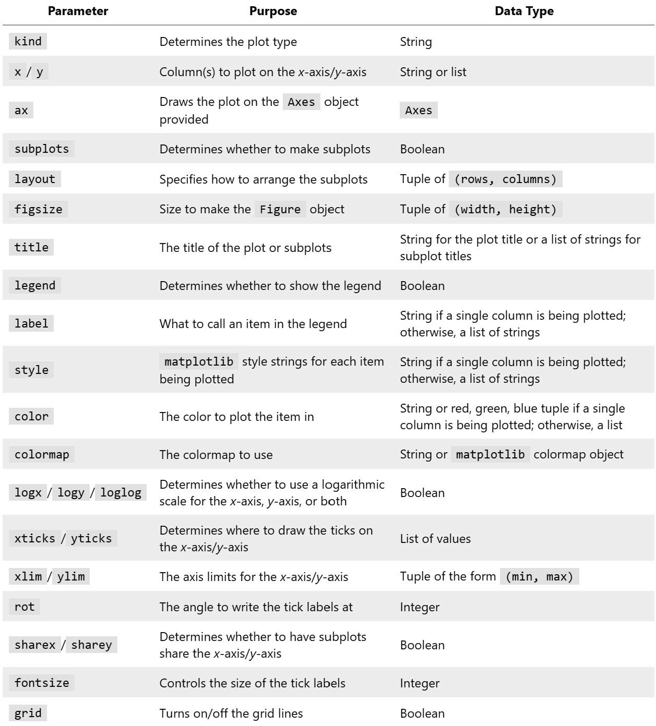
Plotting with pandas
Under the hood, pandas is making several calls to matplotlib to produce our plot.
Some of the most frequently used arguments to the plot() method include the following:
Notes:
Both Series and DataFrame objects have a plot() method that allows us to create several different plots and control some aspects of their formatting, such as subplot layout, figure size, titles, and whether to share an axis across subplots. This makes plotting our data much more convenient, as the bulk of the work to create presentable plots is achieved with a single method call.
Rather than having separate functions for each plot type, as we saw during our discussion of matplotlib, the plot() method from pandas allows us to specify the type of plot we want using the kind argument. The choice of plot will determine which other arguments are required. We can use the Axes object that's returned by the plot() method to further modify our plot.
Let's explore this functionality in the 2-plotting_with_pandas.ipynb notebook.

Slide 35
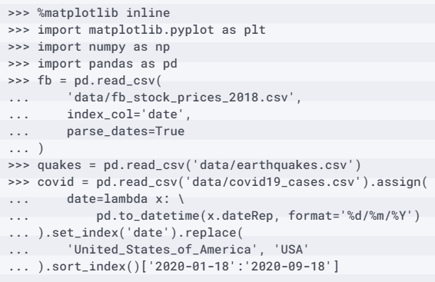
Plotting with pandas
Before we begin, we need to handle our imports for this section and read in the data we will be using (Facebook stock prices, earthquakes, and COVID-19 cases):
Notes:
In the next few sections, we will discuss how to generate an appropriate visualization for a specific analysis goal, such as showing the evolution over time or the relationship between the variables in the data. Note that, wherever possible, the plots have been styled so that they can be interpreted in black and white for this course.

Slide 36
Evolution over time
Additionally, notice that we can provide a format string to the style argument, just like we did with the matplotlib plots:
>>> fb.plot(
... kind='line', y='open', figsize=(10, 5), style='-b',
... legend=False, title='Evolution of Facebook Open Price'
... )
Notes:
When working with time series data (such as the Facebook stock data stored in the fb variable), we often want to show how the data has changed over time. To do this, we use line plots and, in some cases, bar plots (covered in the Counts and frequencies section). In the case of a line plot, we simply provide kind='line' to plot(), indicating which columns will be x and y. Note that we actually don't need to provide a column for x because pandas, by default, will use the index (this also makes it possible to generate the line plot of a Series object).

Slide 37
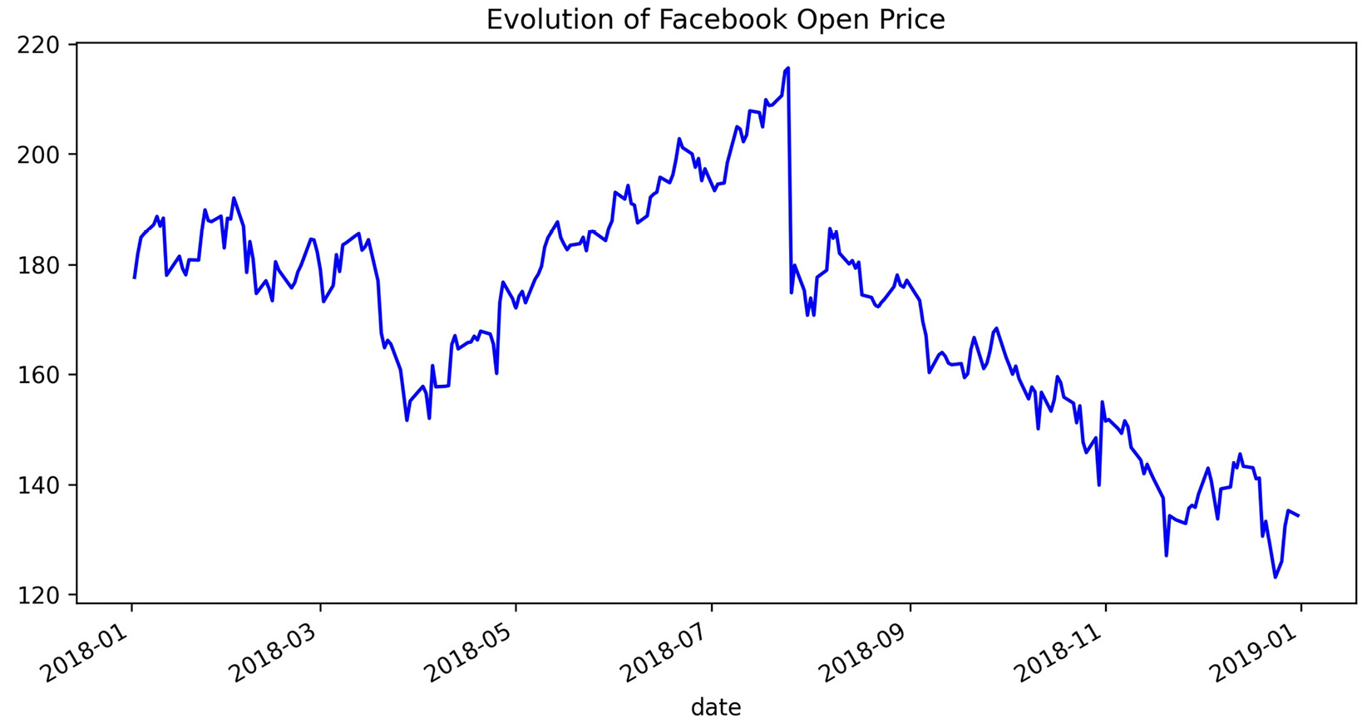
Evolution over time
This gives us a plot similar to what we achieved with matplotlib; however, in this single method call, we specified the figure size for this plot only, turned off the legend, and gave it a title:

Slide 38
Evolution over time
As with matplotlib, we don't have to use the style format strings—instead, we can pass each component separately with its associated keyword.
For example, the following code gives us the same result as the previous one:
fb.plot(
kind='line', y='open', figsize=(10, 5),
color='blue', linestyle='solid',
legend=False, title='Evolution of Facebook Open Price'
)

Slide 39
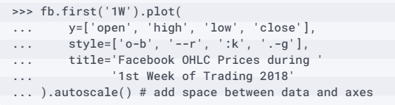
Evolution over time
We aren't limited to plotting one line at a time with the plot() method; we can also pass in a list of columns to plot and style them individually.
Note that we actually don't need to specify kind='line' because that is the default:

Slide 40
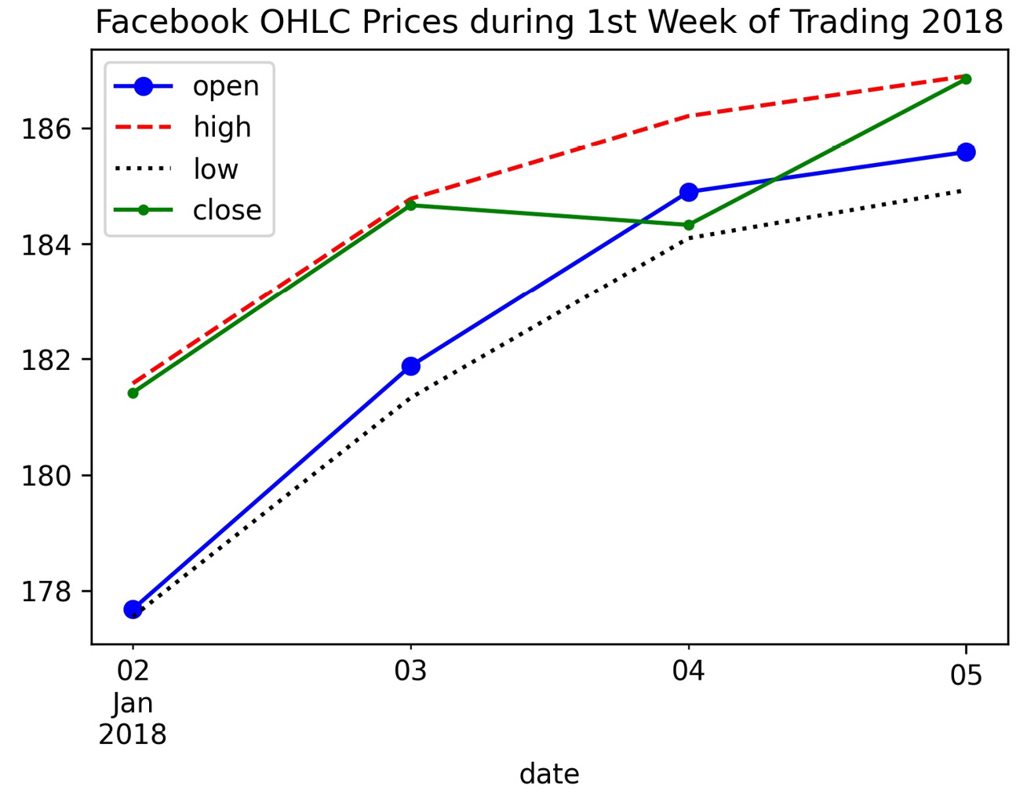
Evolution over time
This results in the following plot, where each line is styled differently:
Notes:
Additionally, we can easily have pandas plot all our columns in that same call. The x and y arguments can take a single column name or a list of them; if we provide nothing, pandas will use all of them. Note that the columns must be passed as the y argument when kind='line'; however, other plot types support passing lists of columns to x as well. In this case, it may be helpful to ask for subplots instead of having all the lines on the same plot.

Slide 41
Evolution over time
Let's visualize all the columns in the Facebook data as line plots:
>>> fb.plot(
... kind='line', subplots=True, layout=(3, 2),
... figsize=(15, 10), title='Facebook Stock 2018'
... )

Slide 42
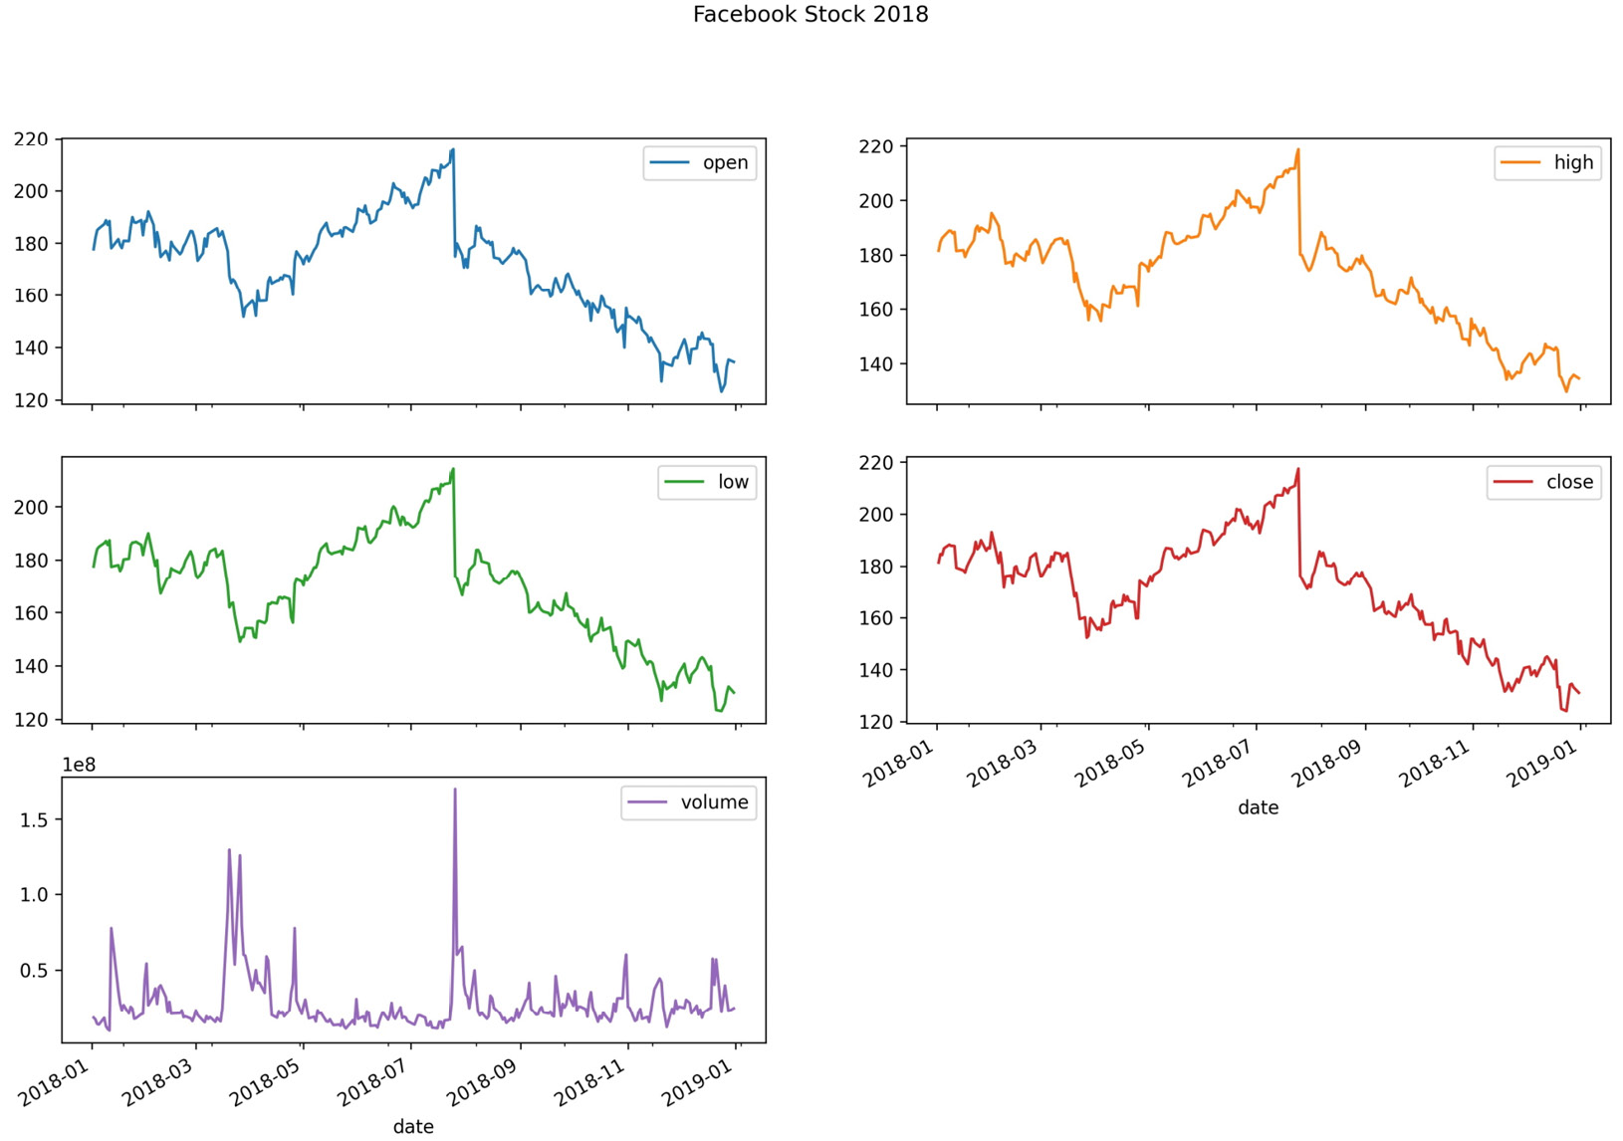
Evolution over time
Using the layout argument, we told pandas how to arrange our subplots (three rows and two columns):
Notes:
Notice that the subplots automatically share the x-axis, since they share an index. The y-axis is not shared because the volume time series is on a different scale. We can alter this behavior in some plot types by passing the sharex or sharey argument with a Boolean to plot(). The legend will be rendered by default, so, for each subplot, we have a single item in the legend indicating which data it contains. We didn't provide a list of subplot titles with the title argument in this case, since the legend served that purpose; however, we passed a single string for the title of the plot as a whole. To summarize, when working with subplots, we have two options when it comes to the title:
Passing a single string for the title of the figure as a whole.
Passing a list of strings to use as the title for each subplot.
Sometimes, we want to make subplots where each has a few variables in them for comparison. This can be achieved by first creating the subplots with plt.subplots() and then providing the Axes objects to the ax parameter. To illustrate this, let's take a look at daily new cases of COVID-19 in China, Spain, Italy, the USA, Brazil, and India. This is long format data, so we must first pivot it so that the dates (which we set as the index when we read in the CSV file) are in the index of the pivot table and the countries (countriesAndTerritories) are in the columns.

Slide 43
Evolution over time
Since there is a lot of fluctuation in these values, we will plot the 7-day moving average of new cases using the rolling() method introduced in lesson 4, Aggregating Pandas DataFrames:
>>> new_cases_rolling_average = covid.pivot_table(
... index=covid.index,
... columns='countriesAndTerritories',
... values='cases'
... ).rolling(7).mean()
Notes:
Rather than create a separate plot for each country (which makes it harder to compare) or plot them all together (which will make it difficult to see the smaller values), we will plot countries that have had a similar number of cases in the same subplot.

Slide 44
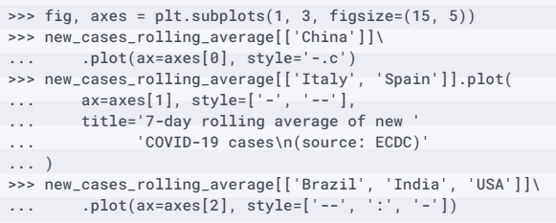
Evolution over time
We will also use different line styles in order to distinguish between them in black and white:

Slide 45
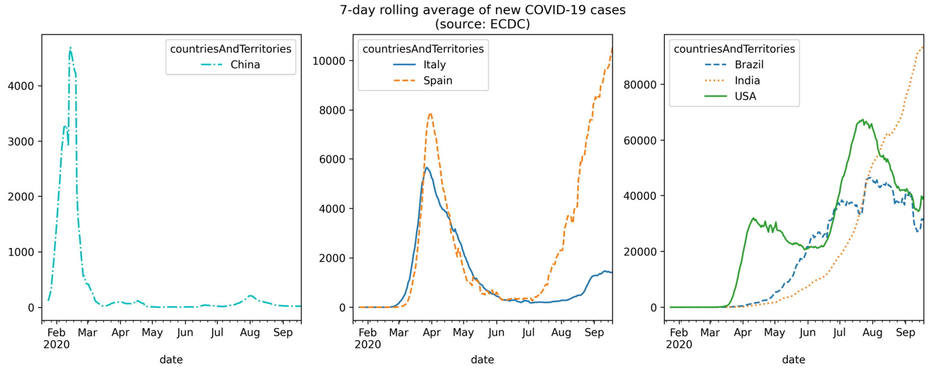
Evolution over time
By directly using matplotlib to generate the Axes objects for each subplot, we gained a lot more flexibility in the resulting layout:
Notes:
In the previous plot, we were able to compare countries with similar levels of daily new COVID-19 cases, but we couldn't compare all of them in the same subplot due to scale. One way to get around this is to use an area plot, which makes it possible for us to visualize the overall 7-day rolling average of new COVID-19 cases and, at the same time, how much each country is contributing to the total.

Slide 46
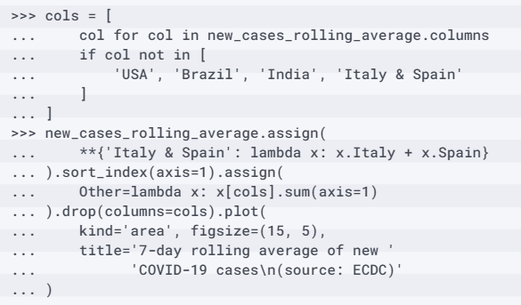
Evolution over time
In the interest of readability, we will group Italy and Spain together and create another category for countries other than the USA, Brazil, and India:
Notes:
For those viewing the resulting plot in black and white, Brazil is the bottom layer, with India on top of it and so on. The combined height of the plot areas is the overall value, and the height of a given shaded region is the value for that country.

Slide 47
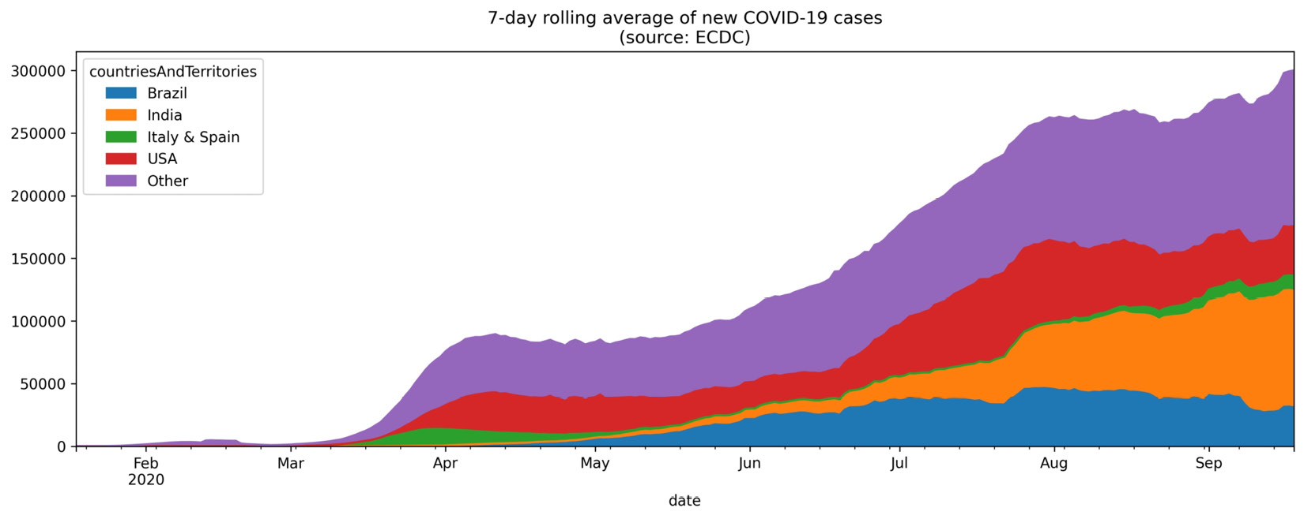
Evolution over time
This shows us that more than half of the daily new cases are in Brazil, India, Italy, Spain, and the USA combined:
Notes:
Another way to visualize evolution over time is to look at the cumulative sum over time. Let's plot the cumulative number of COVID-19 cases in China, Spain, Italy, the USA, Brazil, and India, using the ax parameter to once again to create subplots.

Slide 48
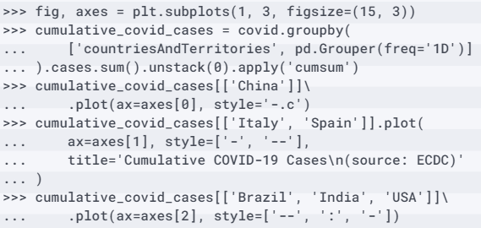
Evolution over time
To calculate the cumulative sum over time, we group by the location (countriesAndTerritories) and the date, which is our index, so we use pd.Grouper(); this time, we will use groupby() and unstack() to pivot our data into wide format for the plot:

Slide 49
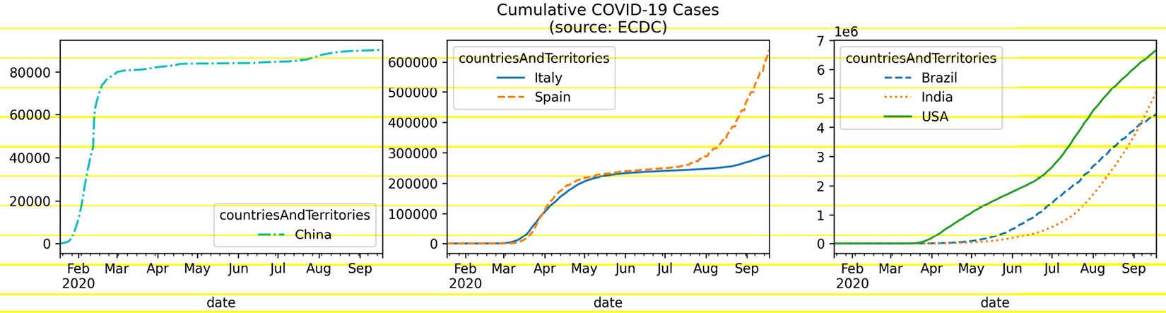
Evolution over time
Viewing the cumulative COVID-19 cases shows that while China and Italy appear to have COVID-19 cases under control, Spain, the USA, Brazil, and India are struggling:
Notes:
Important note
We used dotted and dashed lines multiple times in this section to ensure that the resulting plots could be interpreted in black and white; note, however, that accepting the default colors and line styles will suffice when presenting these plots in color. Often, different line styles signify a difference in the data types—for example, we could use a solid line for the evolution over time and a dashed line to represent the rolling average.

Slide 50
Relationships between variables
We can use a scatter plot to visualize this relationship:
>>> fb.assign(
... max_abs_change=fb.high - fb.low
... ).plot(
... kind='scatter', x='volume', y='max_abs_change',
... title='Facebook Daily High - Low vs. Volume Traded'
... )
Notes:
When we want to visualize the relationship between variables, we often begin with scatter plots, which show us the value of the y variable at different values of the x variable. This makes it very easy for us to spot correlations and possible non-linear relationships. In the previous lesson, when we looked at the Facebook stock data, we saw that the days of high volume traded appeared to be correlated with large drops in stock price.

Slide 51
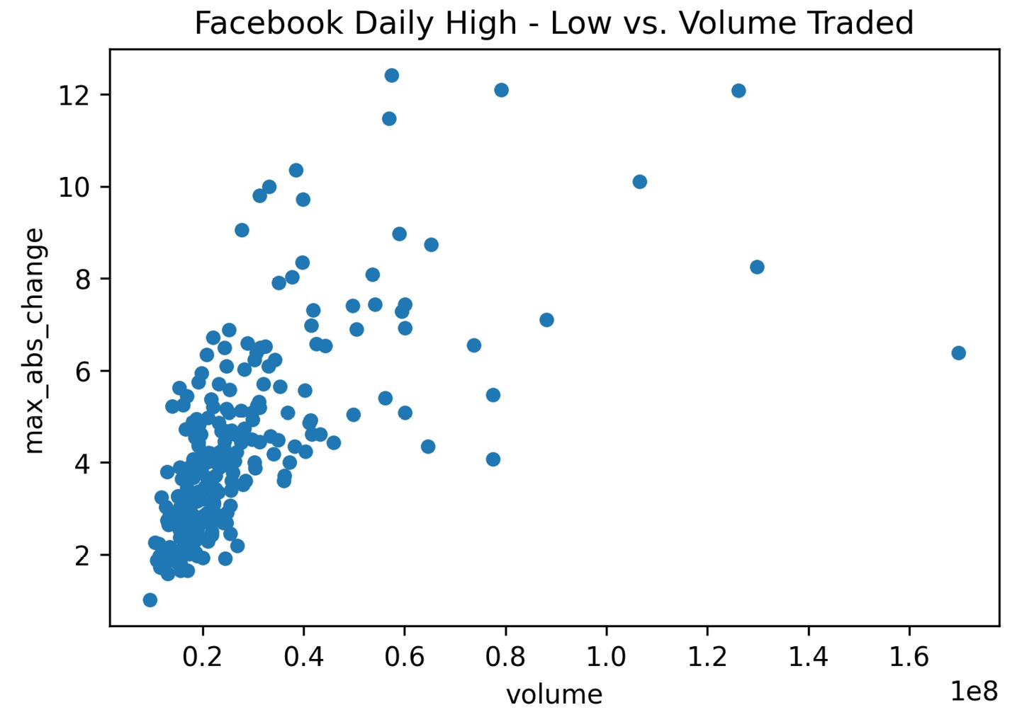
Relationships between variables
There appears to be a relationship, but it does not seem linear:

Slide 52
Relationships between variables
Let's try taking the logarithm (log) of the volume.
To do so, we have a couple of options:
Create a new column that is the log of the volume using np.log().
Use a logarithmic scale for the x-axis by passing in logx=True to the plot() method or calling plt.xscale('log').

Slide 53
Relationships between variables
In this case, it makes the most sense to simply change how we display our data, since we aren't going to use the new column:
>>> fb.assign(
... max_abs_change=fb.high - fb.low
... ).plot(
... kind='scatter', x='volume', y='max_abs_change',
... title='Facebook Daily High - '
... 'Low vs. log(Volume Traded)',
... logx=True
... )

Slide 54
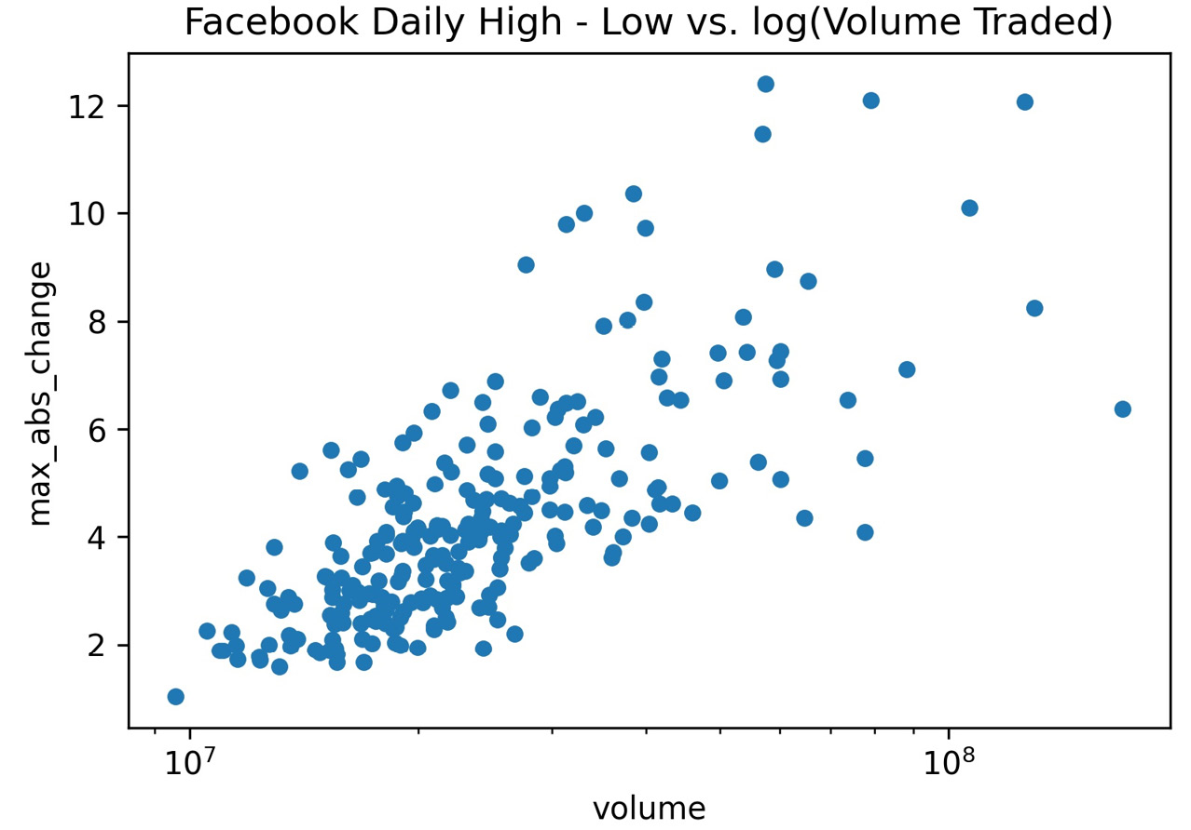
Relationships between variables
After modifying the x-axis scale, we get the following scatter plot:
Notes:
Tip
The plot() method from pandas has three arguments for logarithmic scales: logx/logy for single axis adjustments and loglog for setting both to the logarithmic scale.
One problem with scatter plots is that it can be very difficult to discern the concentration of points in a given area, since they are simply plotted one of top of the other. We can use the alpha argument to control the transparency of the points; this argument takes values from 0 to 1, where 0 is entirely transparent and 1 is completely opaque.

Slide 55
Relationships between variables
By default, they are opaque (value of 1); however, if we make them more transparent, we should be able to see some of the overlap:
>>> fb.assign(
... max_abs_change=fb.high - fb.low
... ).plot(
... kind='scatter', x='volume', y='max_abs_change',
... title='Facebook Daily High - '
... 'Low vs. log(Volume Traded)',
... logx=True, alpha=0.25
... )

Slide 56
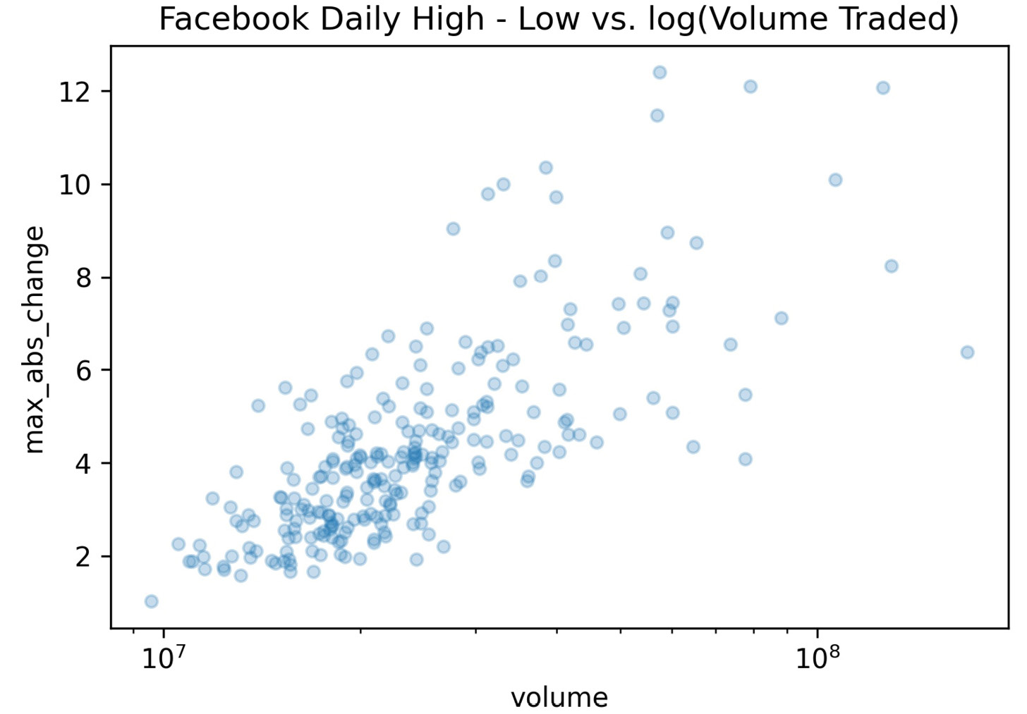
Relationships between variables
We can now begin to make out the density of points in the lower-left region of the plot, but it's still relatively difficult:
Notes:
Thankfully, we have another plot type at our disposal: hexbin. Hexbins form a two-dimensional histogram by dividing the plot into a grid of hexagons and shading them based on the concentration of points in each bin.

Slide 57
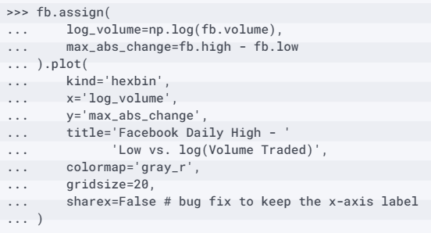
Relationships between variables
Let's view this data as hexbins:
Notes:
The colorbar on the side indicates the relationship between color and the number of points in that bin. The colormap we chose (gray_r) shades the bins darker (toward black) for high density, and lighter (toward white) for low density. By passing in gridsize=20, we are specifying that 20 hexagons should be used across the x-axis, and then having pandas determine how many to use along the y-axis so that they are approximately regular in shape; we can, however, pass a tuple to choose the number in both directions.

Slide 58
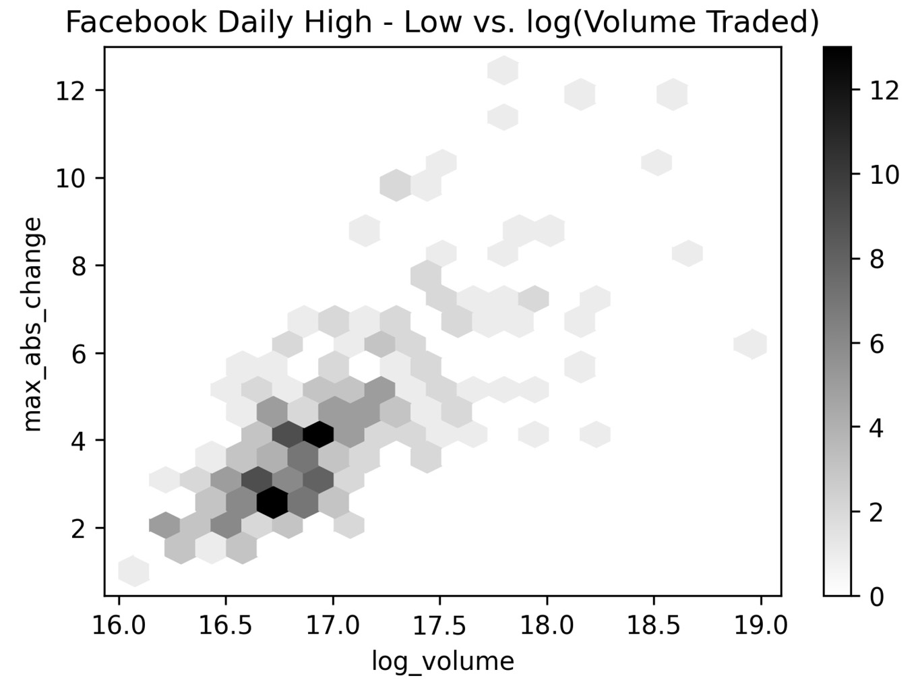
Relationships between variables
A larger value for gridsize will make the bins harder to see, while a smaller one will result in fuller bins that take up more space on the plot—we must strike a balance:
Notes:
Finally, if we simply want to visualize the correlation between variables, we can plot a correlation matrix. A correlation matrix depicts the magnitude and direction (positive or negative) of the correlation. Let's take a look at the correlation matrix for the Facebook data we have been working with. To do so, we can use a combination of pandas and either the plt.matshow() or plt.imshow() function from matplotlib.

Slide 59
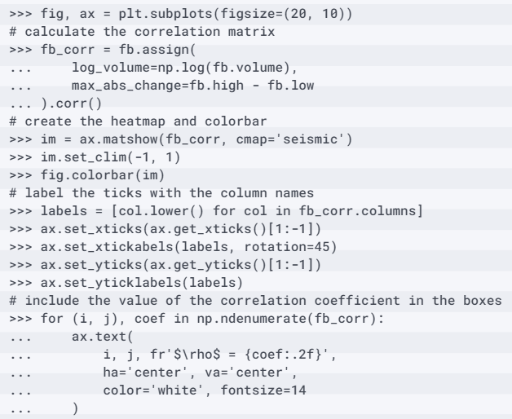
Relationships between variables
Since there is a lot of code that needs to be run in the same cell, we will discuss the purpose of each section immediately after this code block:
Notes:
A heatmap lets us easily visualize the correlation coefficients, provided we choose a diverging colormap—we will discuss the different types of colormaps when we discuss customizing plots in lesson 6, Plotting with Seaborn and Customization Techniques. Essentially, for this plot, we want red for correlation coefficients greater than zero and blue for those below; correlation coefficients near zero will be devoid of color, and stronger correlations will be darker shades of their respective colors.

Slide 60
Relationships between variables
This can be achieved by selecting the seismic colormap and then setting the limits of the color scale to [-1, 1], since the correlation coefficient has those bounds:
im = ax.matshow(fb_corr, cmap='seismic')
im.set_clim(-1, 1) # set the bounds of the color scale
fig.colorbar(im) # add the colorbar to the figure

Slide 61
Relationships between variables
To be able to read the resulting heatmap, we need to label the rows and columns with the names of the variables in our data:
labels = [col.lower() for col in fb_corr.columns]
ax.set_xticks(ax.get_xticks()[1:-1]) # to handle matplotlib bug
ax.set_xticklabels(labels, rotation=45)
ax.set_yticks(ax.get_yticks()[1:-1]) # to handle matplotlib bug
ax.set_yticklabels(labels)
Notes:
While the color scale will make it easy for us to differentiate between weak and strong correlations, it is often helpful to annotate the heatmap with the actual correlation coefficients. This can be accomplished by using the text() method on the Axes object containing the plot.

Slide 62
Relationships between variables
For this plot, we placed white, center-aligned text indicating the value of the Pearson correlation coefficient for each variable combination:
# iterate over the matrix
for (i, j), coef in np.ndenumerate(fb_corr):
ax.text(
i, j,
fr'$\rho$ = {coef:.2f}', # raw (r), format (f) string
ha='center', va='center',
color='white', fontsize=14
)

Slide 63
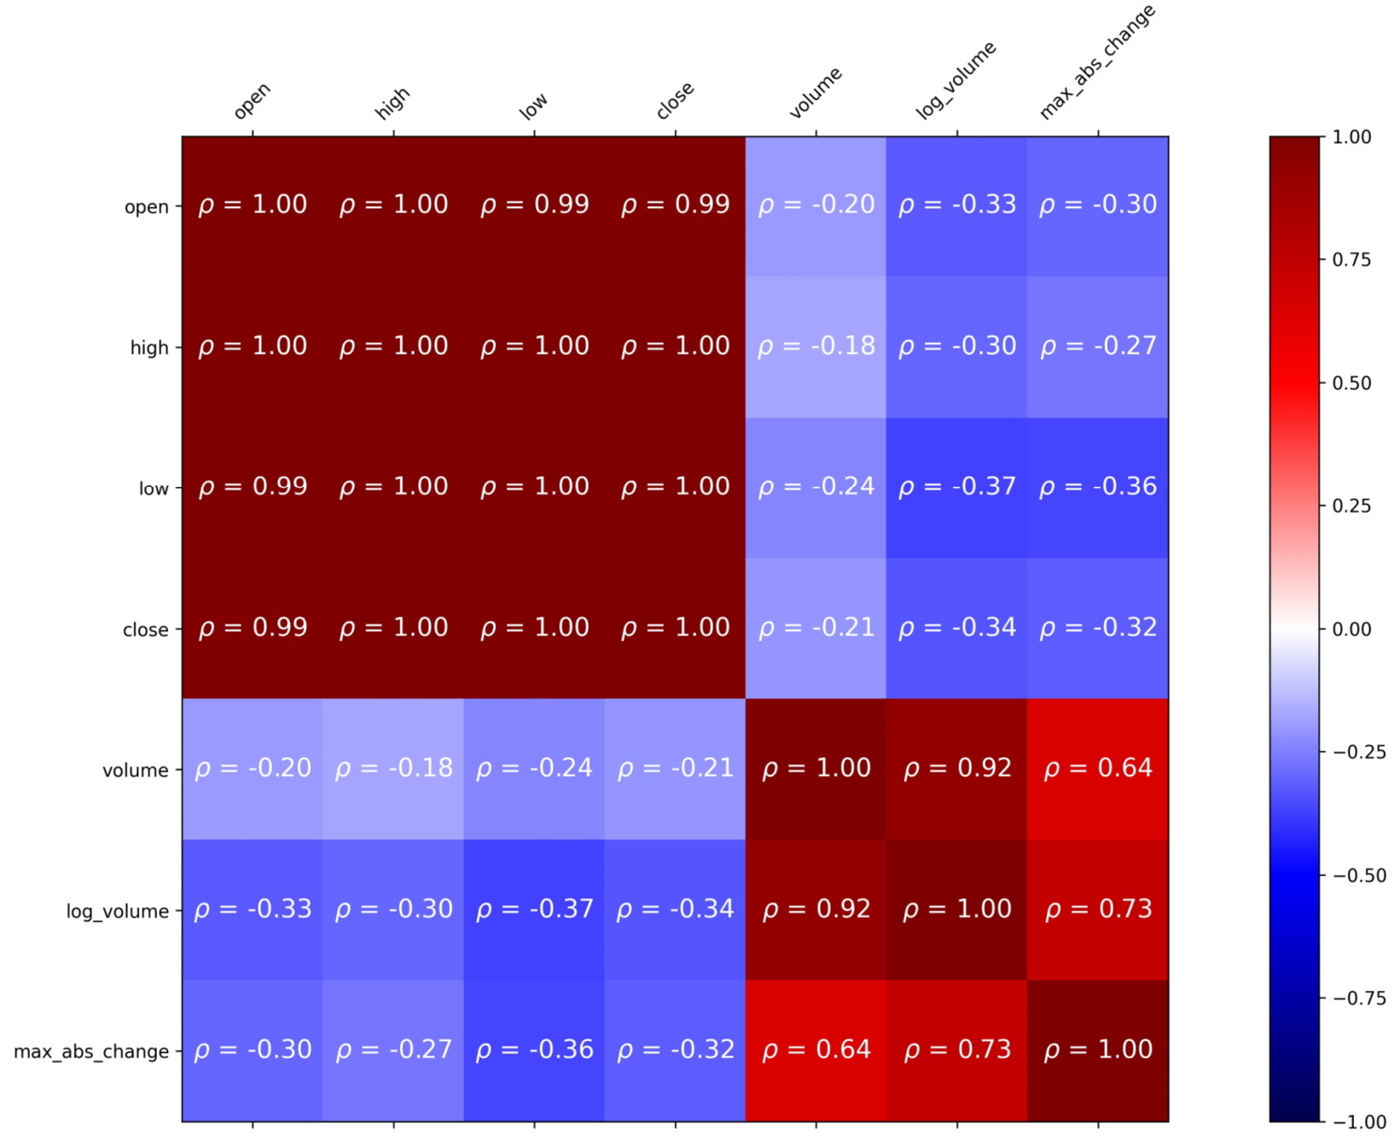
Relationships between variables
This results in an annotated heatmap showing the correlations between the variables in the Facebook dataset:
Notes:
In Figure, we can easily see strong positive correlations among the OHLC time series, as well as among the volume traded and maximum absolute value of change. However, there are weak negative correlations between these groups. Furthermore, we can see that taking the logarithm of the volume does indeed increase the coefficient of correlation with max_abs_change from 0.64 to 0.73. When we discuss seaborn in the next lesson, we will learn an easier way to generate a heatmap, and also cover annotations in more detail.

Slide 64
Distributions
Let's take a look at the histogram of daily volume traded in Facebook stock:
>>> fb.volume.plot(
... kind='hist',
... title='Histogram of Daily Volume Traded '
... 'in Facebook Stock'
... )
>>> plt.xlabel('Volume traded') # label x-axis (see ch 6)
Notes:
Often, we want to visualize the distribution of our data to see what values it takes on. Depending on the type of data we have, we may choose to use histograms, kernel density estimates (KDEs), box plots, or empirical cumulative distribution functions (ECDFs). When working with discrete data, histograms are a good place to start.

Slide 65
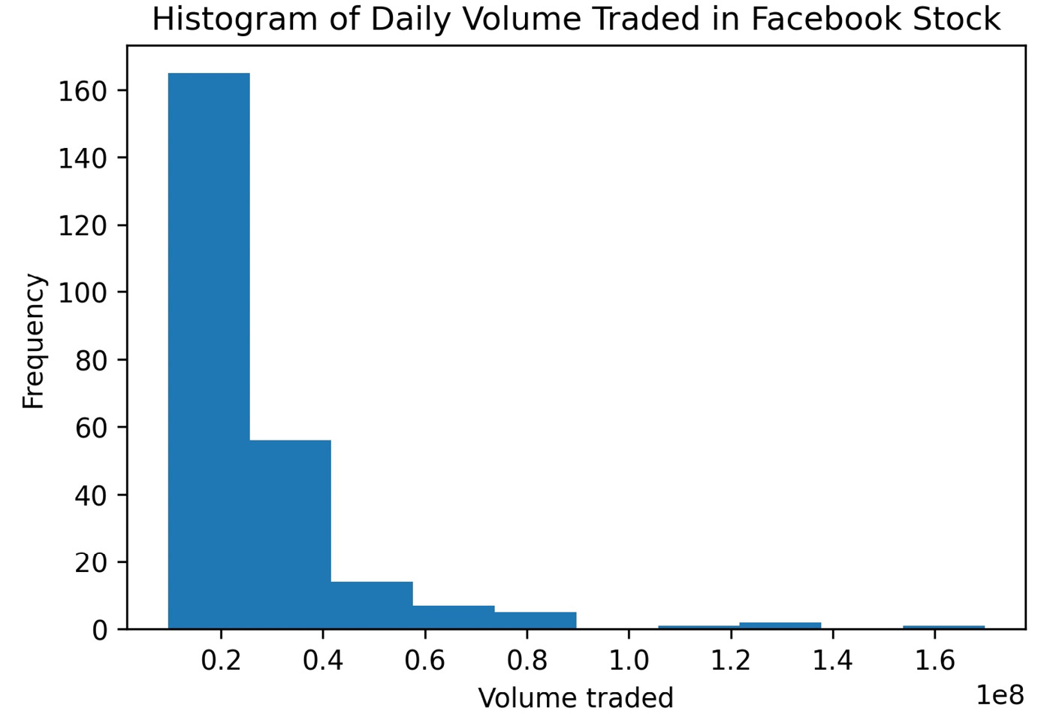
Distributions
Recall that in Aggregating Pandas DataFrames, when we discussed binning and looked at low, medium, and high volume traded, almost all of the data fell in the low bucket, which aligns with what we see in this histogram:
Notes:
This is a great example of real-world data that is, most definitely, not normally distributed. The volume traded is right skewed, with a long tail to the right.
Tip
As with the plt.hist() function from matplotlib, we can provide a custom value for the number of bins with the bins argument. However, we must be careful that we don't misrepresent the distribution.
We can also create multiple histograms on the same plot to compare distributions by using the ax parameter to specify the same Axes object for each plot. In this case, we must use the alpha parameter to see any overlaps.

Slide 66
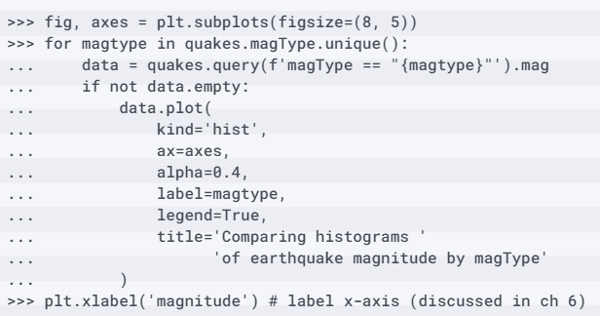
Distributions
Given that we have many different measurement techniques for earthquakes (the magType column), we may be interested in comparing the different ranges of magnitudes they yield:

Slide 67
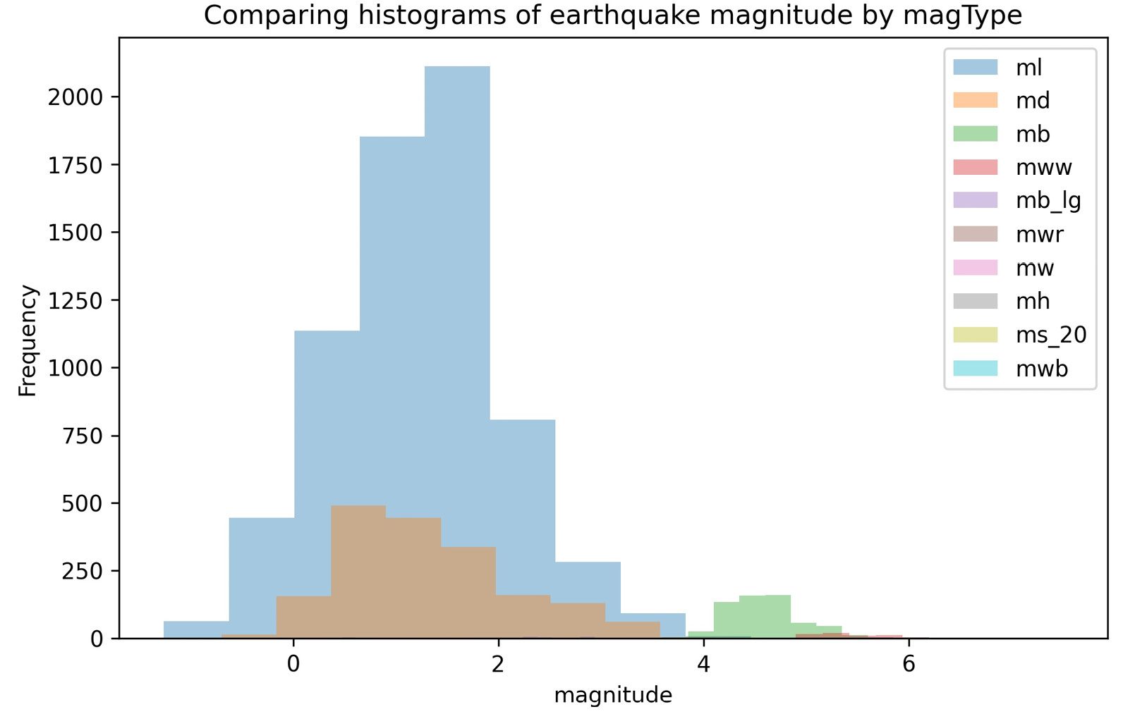
Distributions
This shows us that ml is the most common magType, followed by md, and that they yield similar ranges of magnitudes; however, mb, which is the third-most common, yields higher magnitudes:

Slide 68
Distributions
Note that we can pass either kind='kde' or kind='density':
>>> fb.high.plot(
... kind='kde',
... title='KDE of Daily High Price for Facebook Stock'
... )
>>> plt.xlabel('Price ($)') # label x-axis
Notes:
When working with continuous data (such as stock prices), we can use KDEs. Let's take a look at the KDE of the daily high price for Facebook stock.

Slide 69
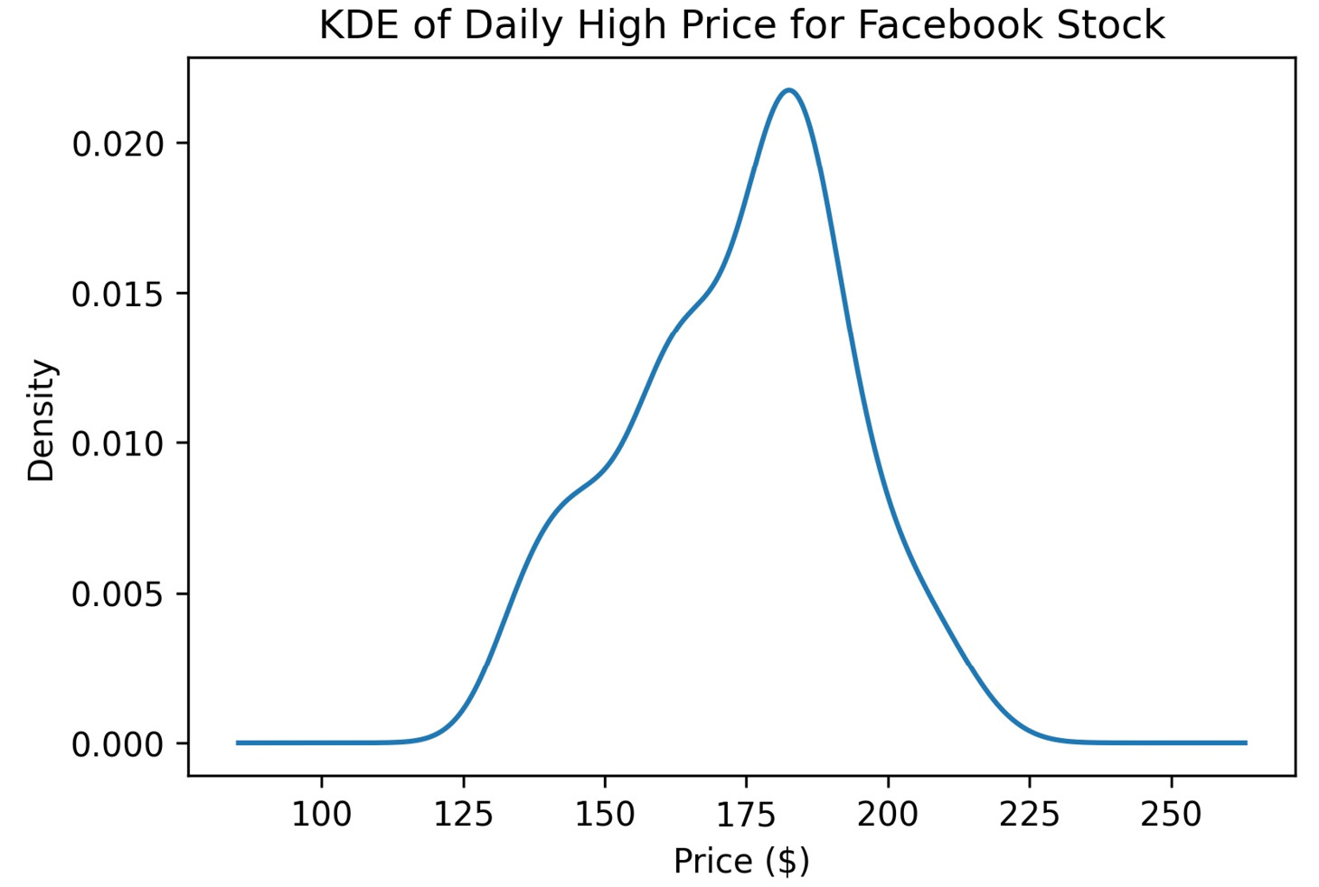
Distributions
The resulting density curve has some left skew:

Slide 70
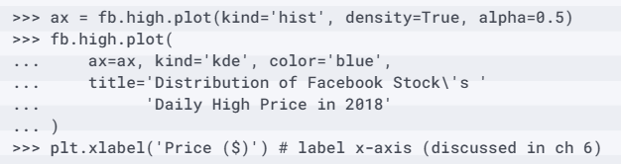
Distributions
We may also want to visualize the KDE superimposed on top of the histogram.
Pandas allows us to pass the Axes object we want to plot on, and also returns one after creating the visualization, which makes this a cinch:
Notes:
Notice that we had to pass density=True when we generated the histogram to make sure that the y-axis for the histogram and KDE were on the same scale. Otherwise, the KDE would have been too small to see. The histogram then gets plotted with density on the y-axis so that we can better understand how the KDE got its shape. We also increased the transparency of the histogram so that we could see the KDE line on top.

Slide 71
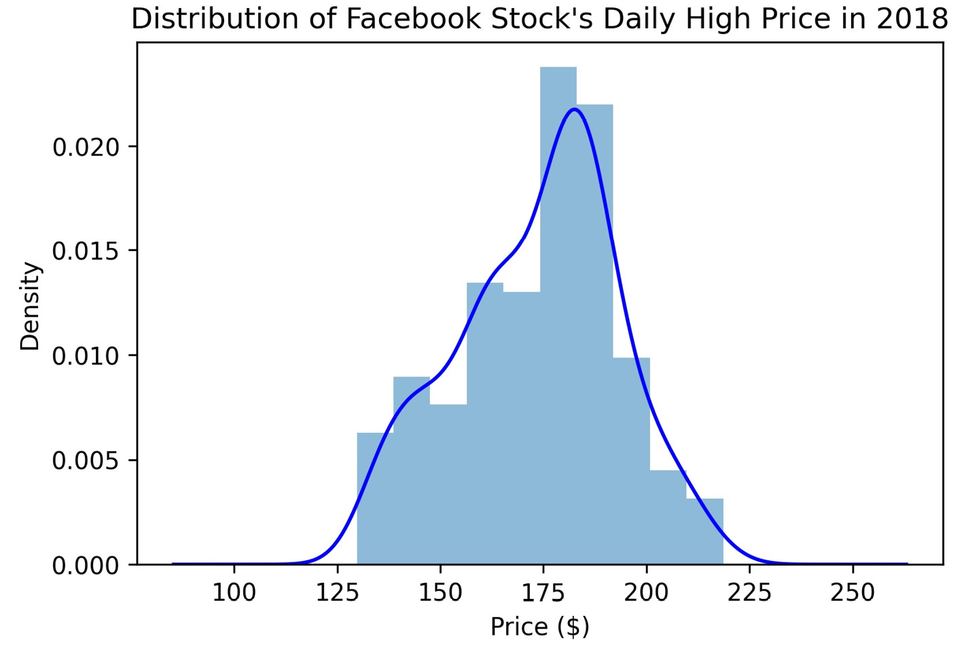
Distributions
Note that if we remove the color='blue' part of the KDE call, we don't need to change the value of alpha in the histogram call because the KDE and histogram will be different colors; we are plotting them both in blue since they represent the same data:
Notes:
The KDE shows us an estimated probability density function (PDF), which tells us how probability is distributed over the values of the data. However, in some cases, we are more interested in the probability of getting less than or equal to (or greater than or equal to) some value, which we can see with the cumulative distribution function (CDF).
Important note
With a CDF, the values for the x variable go along the x-axis, while the cumulative probability of getting, at most, a given x goes along the y-axis. This cumulative probability is between 0 and 1 and is written as P(X ≤ x), where the lowercase (x) is the value for comparison and the uppercase (X) is the random variable, X. More information can be found at https://www.itl.nist.gov/div898/handbook/eda/section3/eda362.htm.

Slide 72
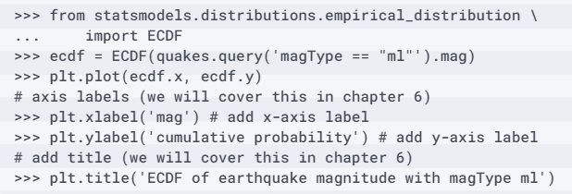
Distributions
Let's use this to understand the distribution of magnitudes for earthquakes measured with the ml magnitude type:
Notes:
Using the statsmodels package, we can estimate the CDF giving us the empirical cumulative distribution function (ECDF).

Slide 73
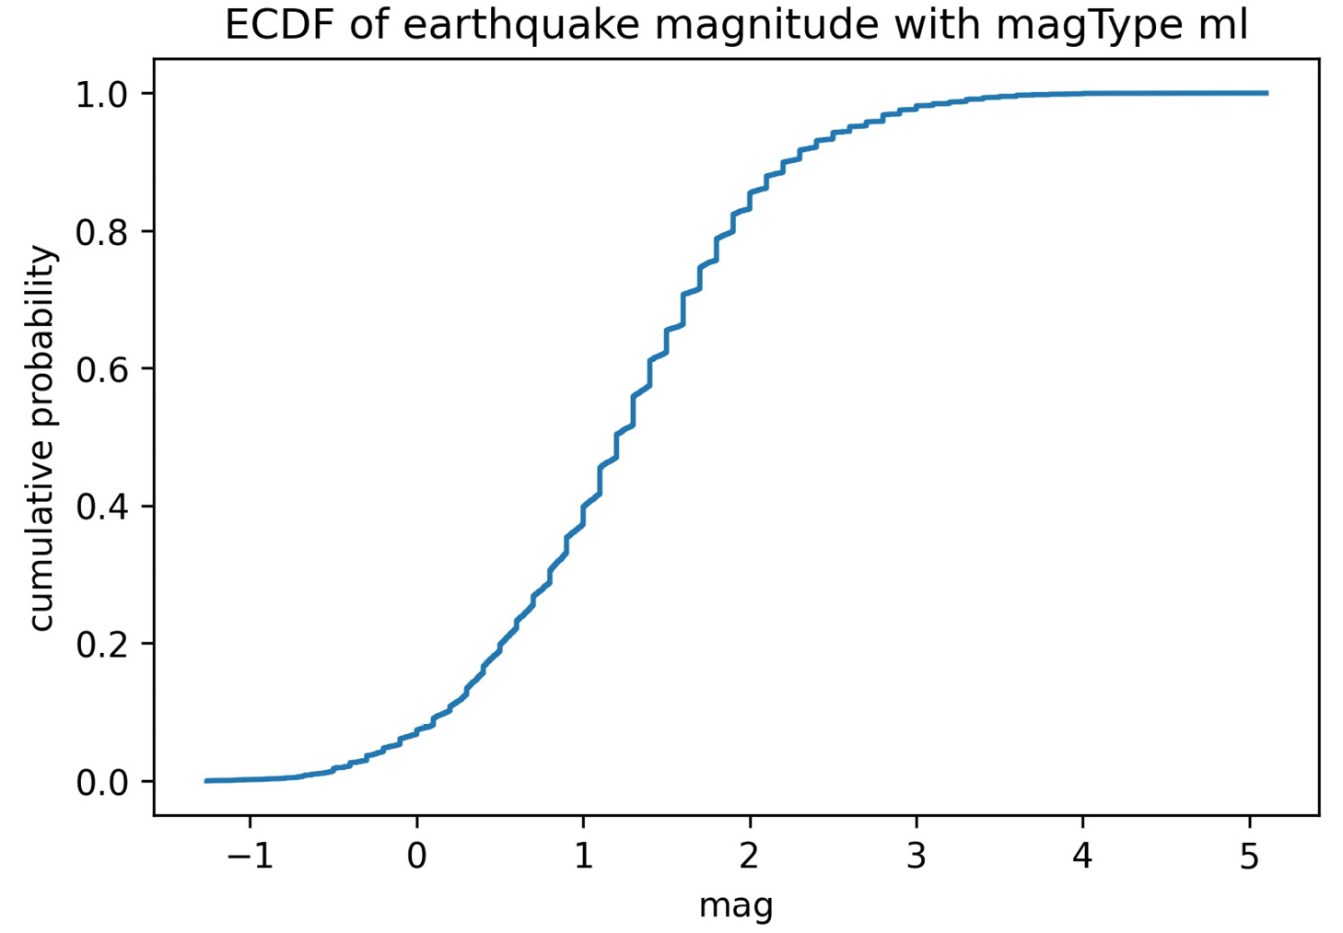
Distributions
This yields the following ECDF:
Notes:
This can be very useful in gaining a better understanding of our data when we conduct our EDA. However, we must be careful how we interpret this and how we explain it to others, if we choose to do so.

Slide 74
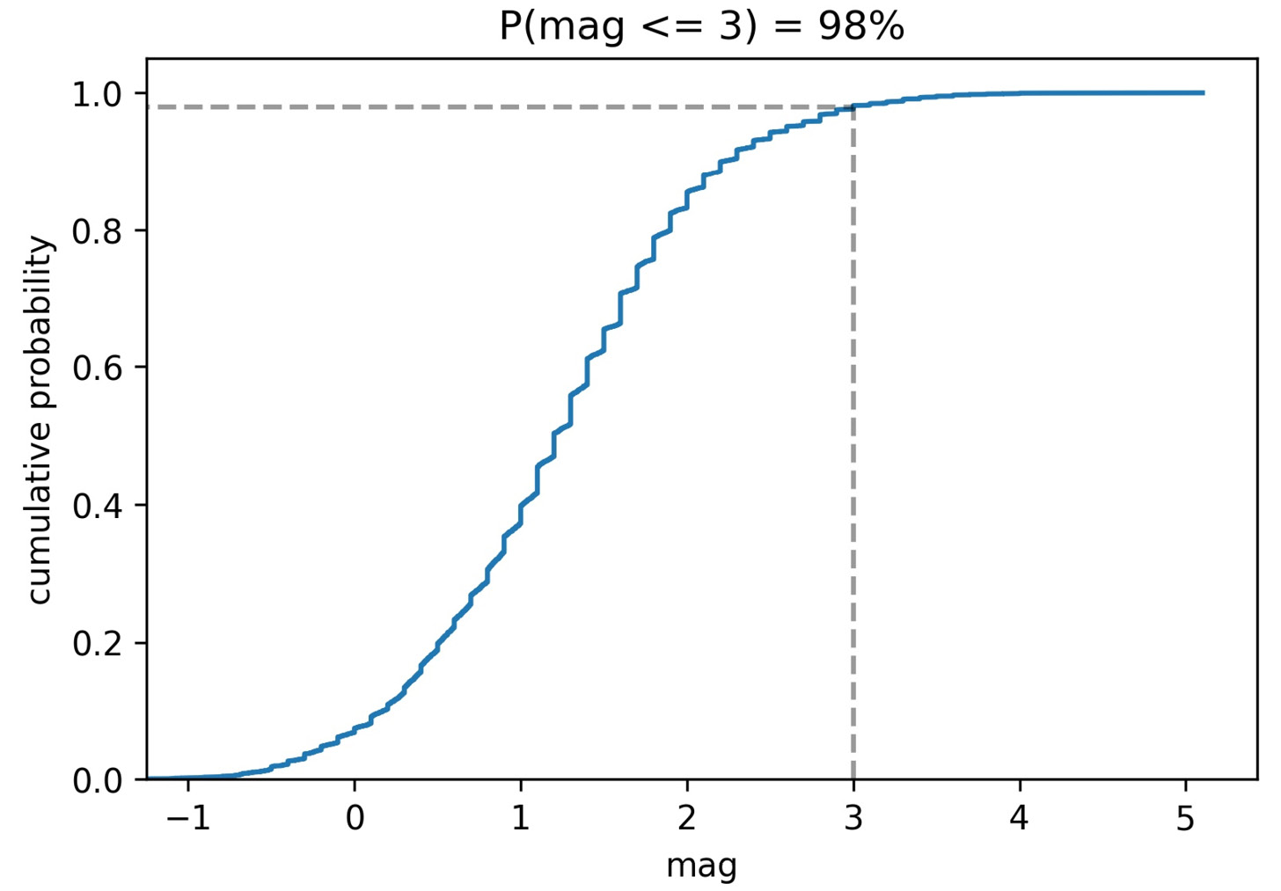
Distributions
Here, we can see that if this distribution is indeed representative of the population, the probability of the ml magnitude of the earthquake being less than or equal to 3 is 98% for earthquakes measured with that measurement technique:
Notes:
This can be very useful in gaining a better understanding of our data when we conduct our EDA. However, we must be careful how we interpret this and how we explain it to others, if we choose to do so.

Slide 75
Distributions
Finally, we can use box plots to visualize potential outliers and the distribution using quartiles.
As an example, let's visualize the OHLC prices for Facebook stock across the whole dataset:
>>> fb.iloc[:,:4].plot(
... kind='box',
... title='Facebook OHLC Prices Box Plot'
... )
>>> plt.ylabel('price ($)') # label x-axis

Slide 76
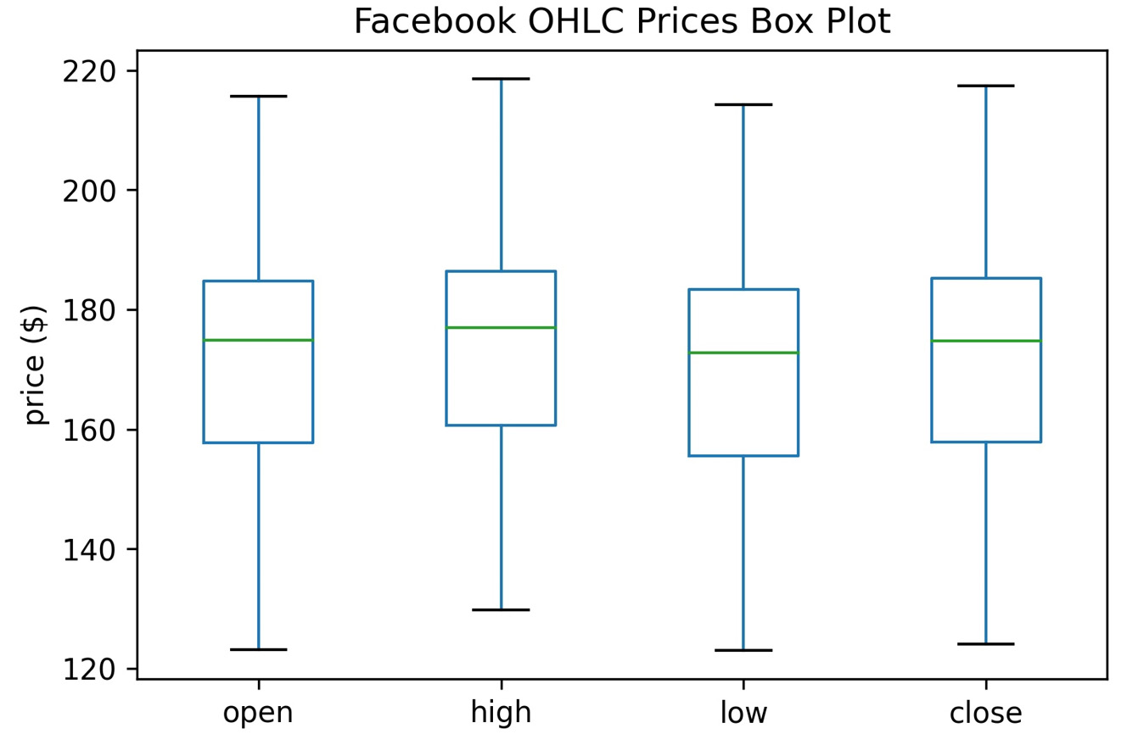
Distributions
We no longer have an idea of the density of points throughout the distribution; with the box plot, we focus on the 5-number summary instead:
Notes:
Notice that we do lose some information we had in the other plots.
Tip
We can create a notched box plot by passing in notch=True. The notch marks a 95% confidence interval around the median, which can be helpful when comparing differences between groups. There is an example in the notebook.
We can also call the boxplot() method after calling groupby().

Slide 77
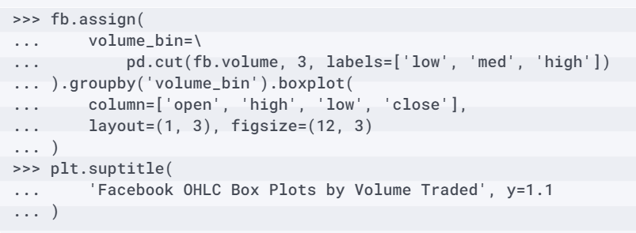
Distributions
Let's examine how the box plots change when we calculate them based on the volume traded:

Slide 78
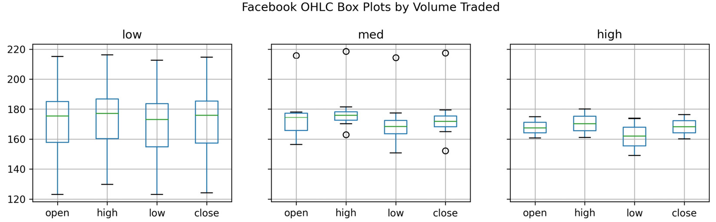
Distributions
Remember that most of the days fell in the low volume traded bucket, so we would expect to see more variation there because of what the stock data looked like over time:

Slide 79
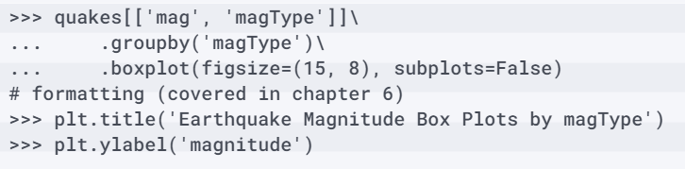
Distributions
We can also use this technique to see the distribution of earthquake magnitudes based on which magType was used and compare it with the expected ranges on the USGS website (https://www.usgs.gov/natural-hazards/earthquake-hazards/science/magnitude-types):
Notes:
The USGS website mentions situations in which certain measurement techniques can't be used and the range of magnitudes each measurement technique is authoritative for (when outside that range, other techniques are used).

Slide 80
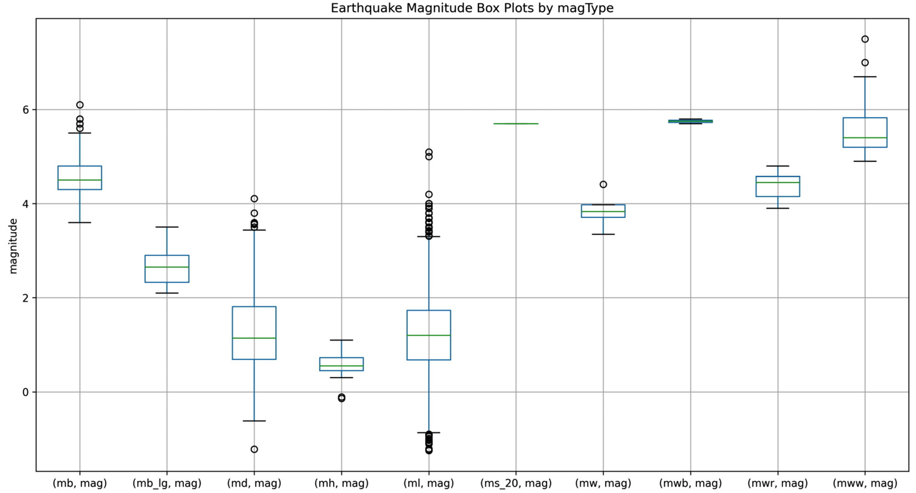
Distributions
Here, we can see that, together, the techniques cover a wide spectrum of magnitudes, while none of them cover everything:
Notes:
Important note
While histograms, KDEs, ECDFs, and box plots are all ways of looking at the distribution of the data, we saw that each visualization showed us a different aspect of it. It's important to visualize the data from many angles before drawing any conclusions.

Slide 81
Counts and frequencies
Note that we could reverse the sort order as an argument to value_counts(), but since we would still have to grab the top 15, we are doing both in a single iloc call:
>>> quakes.parsed_place.value_counts().iloc[14::-1,].plot(
... kind='barh', figsize=(10, 5),
... title='Top 15 Places for Earthquakes '
... '(September 18, 2018 - October 13, 2018)'
... )
>>> plt.xlabel('earthquakes') # label x-axis
Notes:
When working with categorical data, we can create bar plots for displaying counts of our data or frequencies of particular values. The bars can be vertical (kind='bar') or horizontal (kind='barh'). Vertical bar plots are useful when we have many categories or there is some order to the categories (for example, an evolution over time). Horizontal bar plots make it easy to compare the size of each category while allowing sufficient space on the margin for long category names (without the need to rotate them).
We can use a horizontal bar plot to see which places in the quakes dataframe have had the most earthquakes. First, we call the value_counts() method on the parsed_place series and take the top 15 places for earthquakes. Next, we reverse the order so that the smallest ones in this list are on top, which will sort the highest to the top of the bar plot that we will make.
Remember, slicing notation is [start:stop:step], and in this case, since the step is negative, the order is reversed; we start at index 14 (the 15th entry) and get closer to index 0 each time. By passing kind='barh', we get a horizontal bar plot that shows that most of the earthquakes in this dataset occur in Alaska.

Slide 82
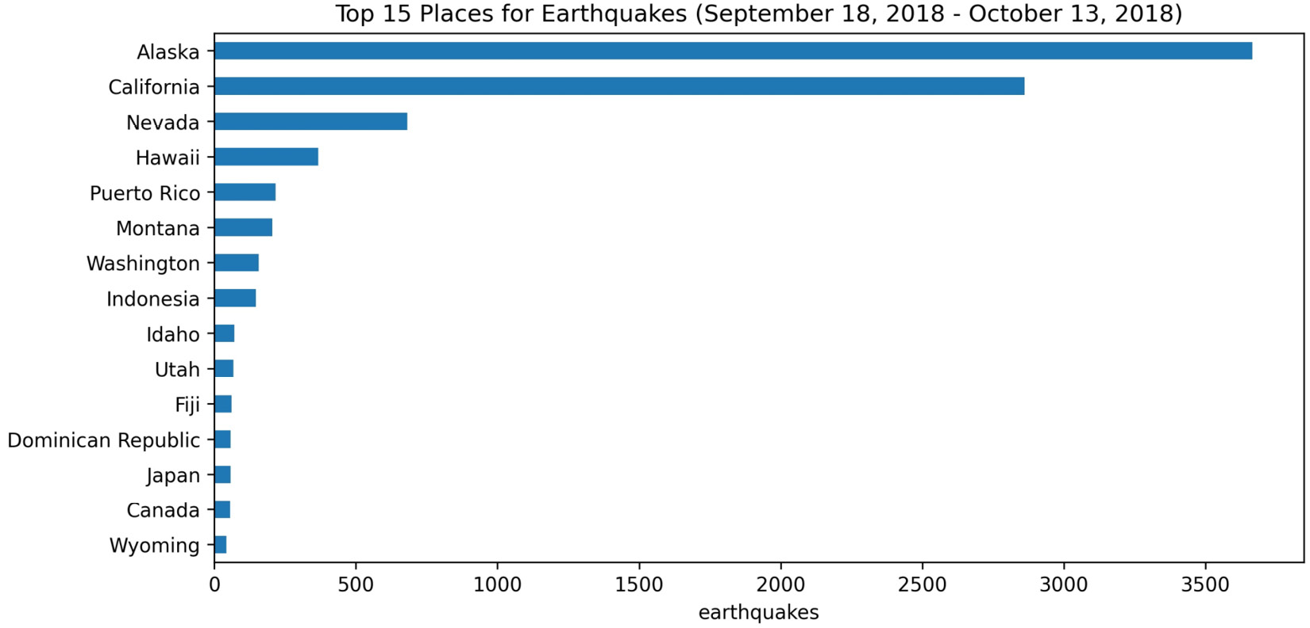
Counts and frequencies
Perhaps it is surprising to see the number of earthquakes over such a short time period, but many of these earthquakes are so small in magnitude that people don't even feel them:
Notes:
Our data also contains information about whether the earthquake was accompanied by a tsunami.

Slide 83
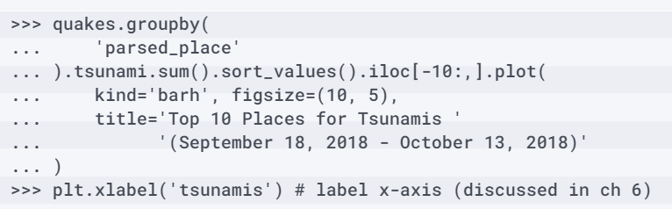
Counts and frequencies
Let's use groupby() to make a bar plot of the top 10 places that were hit by tsunamis during the time period we have in our data:
Notes:
Notice that this time, we used iloc[-10:,], which starts at the 10th largest value (since sort_values() sorts in ascending order by default) and goes to the largest value, giving us the top 10.

Slide 84
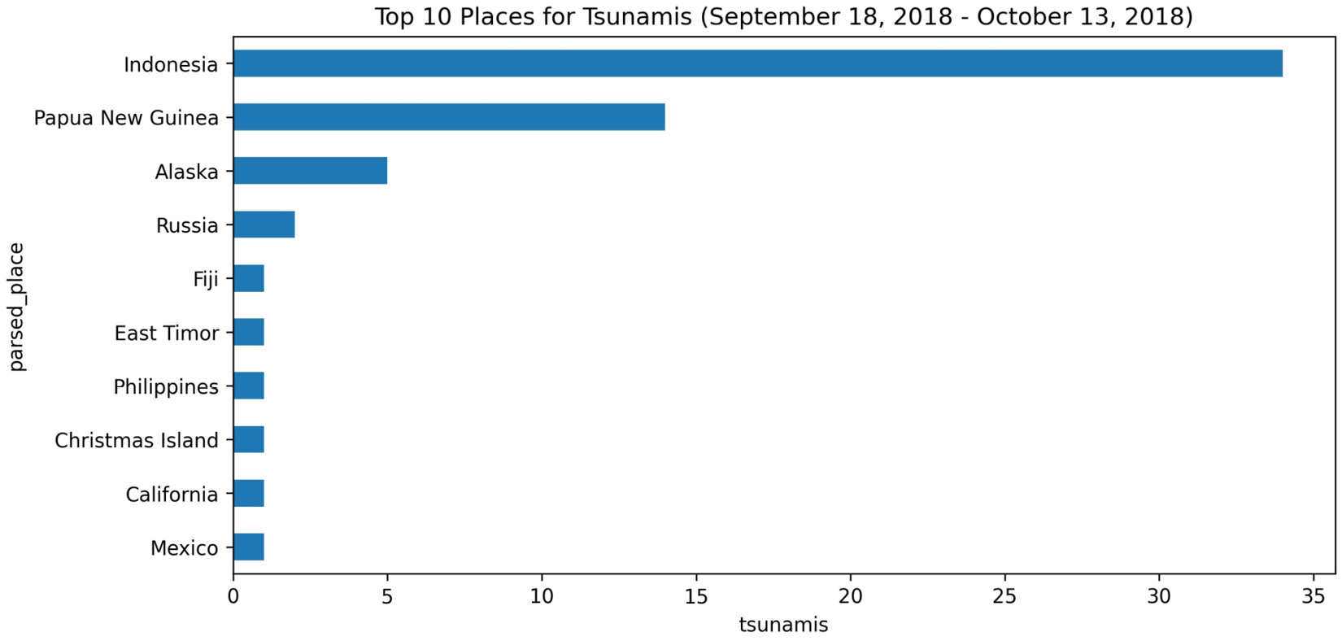
Counts and frequencies
Here, we can see that Indonesia had many more tsunamis than the other places during this time period:
Notes:
After seeing something like this, we may be prompted to look further into the number of tsunamis in Indonesia each day.

Slide 85
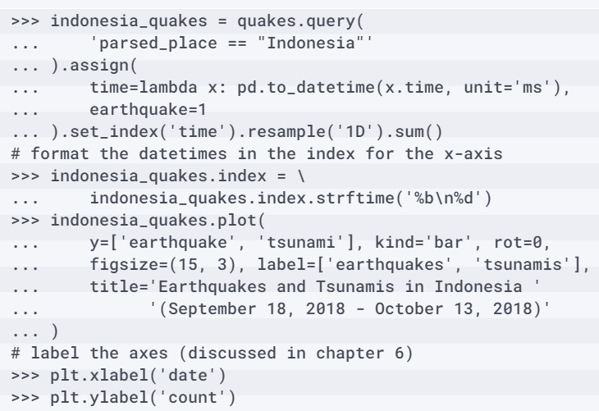
Counts and frequencies
We can visualize this evolution over time as a line plot or with a vertical bar plot by using kind='bar’.
Here, we will use bars to avoid interpolating the points:

Slide 86
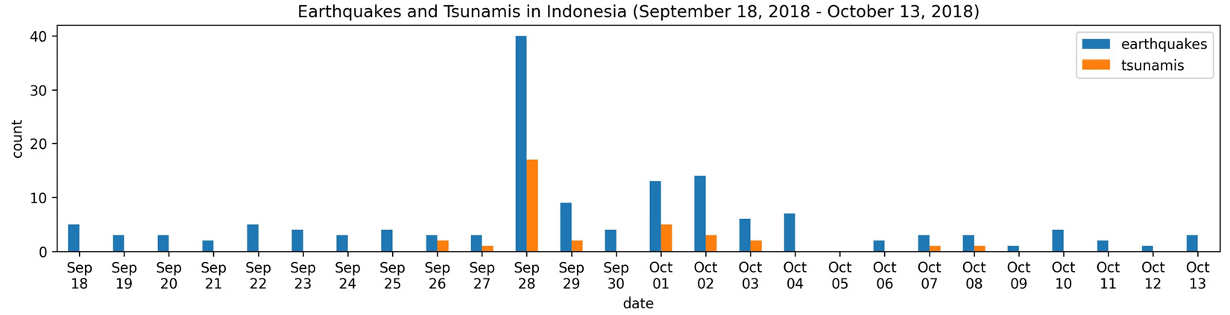
Counts and frequencies
On September 28, 2018, we can see a spike in both earthquakes and tsunamis in Indonesia; on this date a 7.5 magnitude earthquake occurred, causing a devastating tsunami:
Notes:
We can also create grouped bars from a single column's values by using groupby() and unstack(). This makes it possible for us to generate bars for each distinct value in the column. Let's use this strategy to take a look at the frequency of a tsunami accompanying an earthquake, as a percentage. We can handle this using the apply() method, as we learned in lesson 4, Aggregating Pandas DataFrames, along axis=1 (to apply row by row).

Slide 87
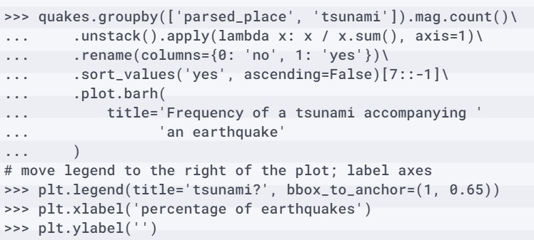
Counts and frequencies
For illustration purposes, we will look at the seven places with the highest percentage of earthquakes accompanied by a tsunami:
Notes:
Christmas Island had one earthquake during this time period, but it was accompanied by a tsunami.

Slide 88

Counts and frequencies
Papua New Guinea, on the other hand, had tsunamis alongside roughly 40% of its earthquakes:
Notes:
Tip
When saving the preceding plots, long category names may get cut off; if that's the case, try running plt.tight_layout() before saving.

Slide 89

Counts and frequencies
Now, let's use vertical bars to see which methods of measuring earthquake magnitude are most prevalent by using kind='bar':

Slide 90

Counts and frequencies
It appears that ml is, by far, the most common method for measuring earthquake magnitudes:
Notes:
This makes sense since it is the original magnitude relationship defined by Richter and Gutenberg in 1935 for local earthquakes, according to the USGS page explaining the magType field in the dataset we are using (https://www.usgs.gov/natural-hazards/earthquake-hazards/science/magnitude-types):

Slide 91
Counts and frequencies
Say we want to see how many earthquakes of a given magnitude there were and to distinguish them by magType.
This shows us a few things in a single plot:
Which magnitudes occur most often across magType.
The relative ranges of magnitude that each magType yields.
The most common values for magType.
Notes:
To do so, we can make a stacked bar plot. First, we will round all magnitudes down to the nearest integer. This means that all earthquakes will be marked as the part of the magnitude before the decimal point (for example, 5.5 gets marked as 5, just like 5.7, 5.2, and 5.0).

Slide 92

Counts and frequencies
Next, we will need to create a pivot table with the magnitude in the index and the magnitude type along the columns; we will count the number of earthquakes for the values:

Slide 93

Counts and frequencies
Once we have the pivot table, we can create a stacked bar plot by passing in stacked=True when plotting:

Slide 94

Counts and frequencies
This results in the following plot, which shows that most of the earthquakes are measured with the ml magnitude type and have magnitudes below four:
Notes:
The other bars are dwarfed in comparison to ml, which makes it difficult for us to see which magnitude types assign higher magnitudes to earthquakes. To address this, we can make a normalized stacked bar plot.

Slide 95

Counts and frequencies
Rather than showing the count of earthquakes for each combination of magnitude and magType, we will show what percentage of earthquakes of a given magnitude used each magType:

Slide 96

Counts and frequencies
Now, we can easily see that mww yields higher magnitudes and that ml appears to be spread across the lower end of the spectrum:
Notes:
Note that we can also use this strategy with a call to the groupby() and then unstack() methods.

Slide 97

Counts and frequencies
Let's revisit the frequency of a tsunami accompanying an earthquake plot, but rather than use grouped bars, we will stack them:

Slide 98

Counts and frequencies
This stacked bar plot makes it very easy for us to compare the frequencies of tsunamis across different places:
Notes:
Categorical data limits us in terms of the types of plots we can use, but there are some alternatives to the bar plot. We will take a look at them in the Utilizing seaborn for advanced plotting section in the next lesson; for now, let's take a look at the pandas.plotting module.

Slide 99
"Complete Exercises"

Slide 100
"Complete Lab 5"

